Slide 1
Rebuilding the Teacher Workforce
Senate presidents’ Forum
Winter 2025 Forum
@LPI_Learning
January 5, 2025
Notes:
Thank partners…

Slide 2
About the Learning Policy Institute
Notes:
LPI - non profit, non partisan think tank that works to advance research and evidence-based policies to support empowering and equitable learning for each and every child.
Our work spans a number of issue areas from educator quality and equitable resources and access to whole child education and early childhood education, among others.
At LPI researchers and policy staff – many of whom wear both hats – work together to put research and policy into action. Which is what we hope comes through today.
[WW – do we need the below? Could cut if we want more time]
Founded by Linda Darling-Hammond in 2015
We conduct, synthesize, and communicate independent, high-quality education-related research to improve education policy and practice.
LPI’s policy theory of action is to bring our research to the state and federal level, which in turn impacts superintendents, principals, teachers, and ultimately students, families, and communities.
We hope that our research and its corresponding policy recommendations get the attention of state and federal policy makers to take action on things that superintendents deal with on a daily basis.
Finally, our research and policy work operate in a continuous cycle, where impacts on educational practice and outcomes inform further research.

Slide 3
Agenda
What do we know about the state of the teacher workforce?
How can states support a well-prepared and stable teacher workforce?
Questions/Discussion

Slide 4
Grounding the Conversation
Teacher preparation, certification, experience, and stability matter for student achievement.
Preparation matters for teacher retention.
Students of color and students from low-income families are disproportionately taught by underprepared and inexperienced teachers.
Notes:
Before we jump in, I want to take a minute to remind ourselves why this conversation about HQ and affordable pathways into education is so impt.
We know that teacher cert, experience, and stability matter for student achievement—seen that borne out in large scale studies, including from NY, NC, and CA.
Research also indicates that teachers without full preparation leave at 2 to 3 times the rates of fully prepared teachers, creating that “leaky bucket” phenomenon that contributes to shortages and undermines school improvement efforts.
candidates who had little to no practice teaching and little to no pedagogical preparation (coursework, feedback on their teaching) were by far the most likely to leave
Finally, this is a core equity issue, b/c these characteristics of teachers are inequitably distributed. That’s unfortunately a pattern we’ve seen borne out over decades in the research.

Slide 5
Teacher shortages affect millions of children
400,000
positions were unfilled or filled by teachers not fully certified for their assignments
1 in 8
of all teaching positions nationally
At least 6 million
children affected by shortages nationally
Source: Franco, M. & Patrick, S. K. (2023). State Teacher Shortages. Learning Policy Institute
Notes:
So given these consequences, how prevalent are teacher shortages?
No national education data
Teacher certification data from 47 states plus DC
Unfilled positions from 21 states
This scan found that…
This underestimates shortages because not all states report…
shortages of this magnitude impact at least 6 million children –
There are a number of drivers of shortages, including a shrinking teacher pipeline, but a key driver of shortages is teacher attrition—teachers leaving the profession, often well before they hit retirement age. As we saw earlier—and many other studies confirm—attrition is strongly related to the preparation that teachers receive. But unfortunately, far too many candidates cannot afford the kind of high-quality preparation that enables them to come into the profession with the greatest likelihood of success; many are coming in on emergency-style permits or no credential at all, and are not yet fully certified.

Slide 6
Teacher shortages impact students
“How have teacher and staff vacancies impacted your school for the 2021-22 school year?”
Source: School Pulse Panel (2022)
Notes:
It is no surprise that these shortages have consequences, as schools simply cannot leave empty classrooms. As a result, data from right after pandemic demonstrated how schools reacted to vacancies after the 2021-22 school year.
Of note, we saw that over 1/6th of all respondents noted that they had to decrease extracurricular offerings and student services, while 20% of schools have had to increase class size, all of which can impact students’ opportunities and ability to learn in supportive learning environments.

Slide 7
The High Cost of Teacher Turnover
About 1 in 6 teachers are leaving their school or the profession annually
(NCES, 2024)
Academic:
Social:
Professional:
Financial:
Students have lower achievement gains in schools with higher turnover
Turnover costs an estimated $25,000 per teacher in a large school district
High turnover lowers trust and damages relationships among teachers and students
Turnover hinders school improvement efforts by disrupting norms and structures
Notes:
Building and retaining a strong and diverse teacher workforce is important for so many reasons, but we wanted to start today’s conversation by describing the costs paid by students, schools, and society when there is high teacher turnover.
First, the most recent national data suggests that about 1 in 6 of all public school teachers are leaving their school or the professional annually. Turnover rates in the United States are much higher than in most other countries and often there is higher turnover among schools serving more students of color or students from low-income households.
Turnover has many consequences and costs [CLICK]
First: numerous studies have found that students have lower achievement gains when they learn in schools or grade-level with higher teacher turnover [CLICK]
Second: Higher turnover among teachers can lower trust and supportive relationships among teachers and their students [CLICK]
Next, school improvement efforts can be stymied by turnover because high levels of staff turnover can disrupt norms, structures, and knowledge-building that are essential to implementing new reforms or improvement efforts.
Finally, there are significant financial costs of turnover. LPI’s recently updated teacher turnover calculator estimates that turnover costs nearly $25,000 per teacher in large school districts.

Slide 8
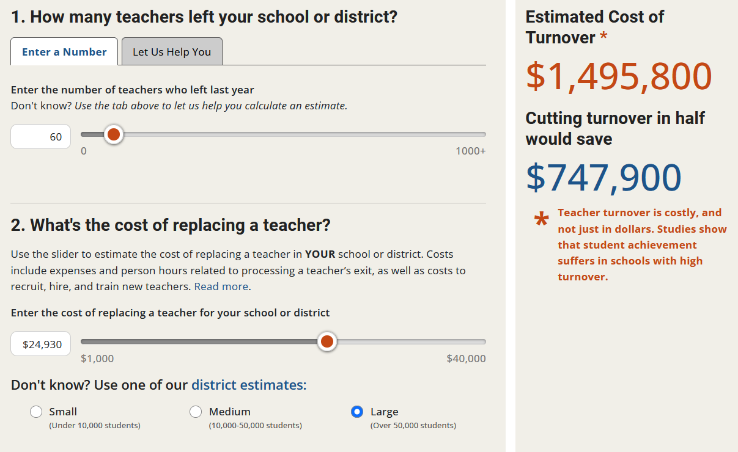
Teacher Churn is Expensive
LPI Teacher Turnover Calculator
Notes:
The consequences of the staff instability and shortages (in terms of student performance, more turnover, etc.) are not just academic. Execessive churn and vacancies also have financial implications, and so if we are able to addressing signals of challenges to the workforce could also be an opportuntiy for cost-savings and raise benefits to the system as a whole.
This is an image from LPI’s calculator to estimate what the cost of teacher turnover is. Source: Learning Policy Institute, What's the Cost of Teacher Turnover? https://learningpolicyinstitute.org/product/the-cost-of-teacher-turnover
This tool shows how much it costs to fill in a vacancy, an amount that varies between $12000 in small districts and $25,000 in large districts (in dollars of 2024).
This may be a helpful too to help illustrate to local decision makers like principals or superintendents to enter in the number of teachers who left, the expected cost of replacing a teacher, and to learn about the overall estimated costs of turnover for their situations.
So you’re seeing here for example, 60 teachers leaving a large school district after one school year can cost teachers nearly 1.5 million dollars.
For example, if we use the most recent count of unfilled positions that some of our Lpi colleagues provided us with earlier this year, in their indepth digging of state level data on both unfilled positions and positions filled with teachers not fully certified for their assignments, filling in the close to 42,000 unfilled vacancies reported by the 31 states with available data would cost between $500 and million over a billion to fill up. [these are #s using 41920 for all small and all large districts as bounds]

Slide 9
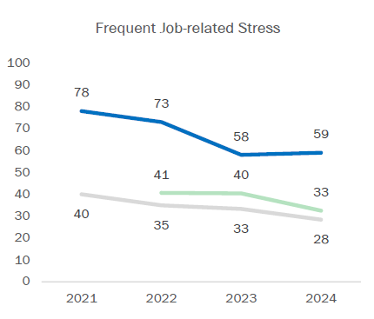
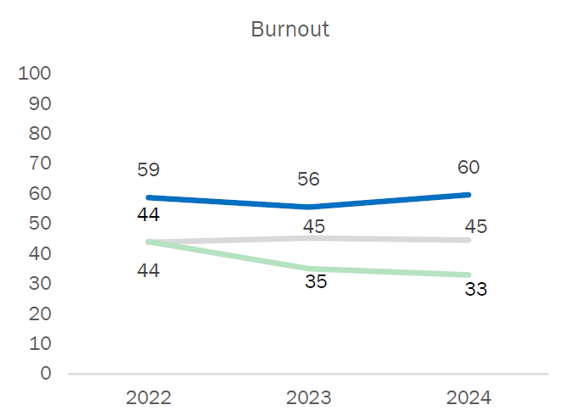
Working conditions and teacher well-being
Source: RAND American Educator Panels (Doan et al., 2024)

Slide 10
2.1 million
1.3 million
400 thousand
Student loan debt can affect
teacher preparation, recruitment, and retention
teachers have ever borrowed for their education (60%)
teachers are still in repayment (37%)
teachers still owe their entire balance (12%)
$342
average monthly payment
Source: https://learningpolicyinstitute.org/product/student-loans-among-teachers-report
Notes:
My colleagues recently completed an analysis of student debt which you see pictured here. Their study analyzed new loan variables included in US Department of Education’s National Teacher and Principal Survey of 2020-21. The study provides a national look, but they also included state-specific information on student loans, 2nd jobs outside the classroom, and several other variables on an interactive map
the prospect of accumulating student loans could deter teacher candidates from pursuing comprehensive preservice preparation, which is higher in quality but may take longer to complete and thus incur greater costs. In some cases, costs dissuade potential candidates from pursuing teaching as a career; and overall, student loans and debt repayment have the potential to exacerbate job-related stress
They found that just over 60% of all full-time, public school teachers—about 2.1 million—have taken out student loans to pay for their education. 1.3 million are repaying their student loans (about 1 in 4 teachers), and 400,000 still owe their entire balance. The avg monthly payment is $342,
ongoing debt burden falls hardest on black teachers, as well as Latino and Native American, Native Hawaiian/Pac Islander teachers, and multiracial teachers. More than 30% of black teachers still owe ALL of their student loans, and almost 60% owe at least some of their loans.
Preparation costs—including whether you can earn a salary/pay the bills while doing a residency/student teaching and learning alongside an expert mentor teacher—is a key driver of why candidates might choose to enter teaching through an alternative cert program or on an emergency-style permit. Nationally, more than twice as many teachers of color are certified via an alternative pathway (25%) as white teachers (12%) (2012 Schools and Staffing Survey data).

Slide 11
How can states strengthen the teacher workforce and reduce turnover?
Notes:
Given these costs, what can states be doing to combat turnover? We have limited time today, but we wanted to introduce one LPI resource that may help state policymakers and leaders think about the state of their teacher workforce and identify areas where they can strengthen the workforce.

Slide 12
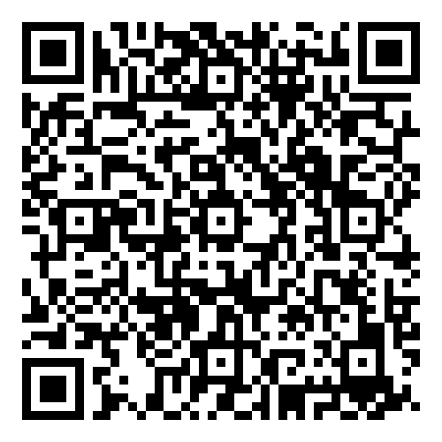
State of the teacher workforce: an interactive tool
Teaching attractiveness
Uses most recent national data to capture 40+ research-based indicators across 3 categories
Shows each state’s data and relative position, and the U.S. data
Two overall ratings
Teaching attractiveness
Teacher equity
Supply and demand
Teacher
equity
Link to interactive map
Notes:
The State of the Teacher Workforce tool is a map that shows national and state statistics on the teacher workforce. CLICK
There are over 40 indicators in the map – these indictors were selected because prior research has indicated that they are important to teacher retention and having a strong teacher labor market. CLICK
The indicators are grouped into three categories, First, we have indicators that measure what we call teaching attractiveness, which is whether states make teaching an attractive profession. Indicators in this bucket include compensation, working conditions, school resources, and teacher turnover.
Second, teacher equity, which shows the extent to which schools serving different shares of students of color and students from low-income backgrounds have equal access to experienced and certified teachers.
Third, other factors that affect the supply and demand for teachers, such as changes in student enrollment.
CLICK
This map shows the data for each state, it also shows that position relative to other states, and the US data.
CLICK
Because there are so many indicators, we created two summary ratings on teaching attractiveness and teacher equity

Slide 13
Overall ratings
Notes:
Here’s what the ratings look like on the map. The green map on the left shows the Teaching Attractiveness Ratings, and the blue map on the right shows the Teacher Equity ratings. We color coded states based on quintiles, and essentially the darker the color, the better it is.
States here shaded darker green are highest ranked in terms of teaching attractiveness. They tend to be clustered in the Midwestern and Northeastern regions.
On the right, states that are a darker blue means a more equitable distribution well-qualified teachers.
Now, we’re going to look at some of the individual indicators on the map.
Comprehensive preservice preparation
Early career mentoring
Positive working conditions
Competitive compensation
As we are thinking about teacher shortages, I first want to offer some grounding about what we know from research about teacher preparation, quality, and diversity. Each of these three attributes operate in tandem and are all crucial to helping curb the severity of teacher shortages.
This is a topic that I'm sure many you all dedicate significant time, care, and attention, so later on we’d love to hear your reactions and experiences as well. [advance]
[If slide is after?]So given persistent teacher shortages, what matters for better recruiting and retaining teachers?
Comprehensive preservice preparation is key. In this case, we mean that teaching candidates take courses of their content expertise, and pedagogical courses in teaching and learning, and have those courses be integrated with in-depth, scaffolded, and extensive clinical practice BEFORE becoming a teacher record.
Prior research has often found that teachers who enter through these routes are not only more likely to be successful with their students, but are also more likely to stay in the profession long-term, especially when compared to teachers who enter through emergency permits or less rigorous pathways.
Unfortunately, we also know that students of color and students from lower income backgrounds tend to be taught by underprepped , so it presents an issue of equitable access when we see teachers entering through fast track programs that fill classrooms with underprepared teachers. [advance]
Research in California shows that those teachers who enter the profession without comprehensive preparation are 2-3 times as likely to leave in their first year as teachers who receive thos most comprehensive preparation: rigorous coursework aligned to robust clinical experience.
As we move along the “pipeline” into the profession, we also know that early career mentoring is also associated with greater retention for beginning teachers. We know that teacher turnover is often highest during these beginning years, so having the collegial support and expertise on navigating the challenges of the early years in the classroom or better understanding the school is a helpful factor to keeping teachers in the classroom. [advance]
However, even if teachers are fully prepared, challenging teaching conditions can push them out of the profession, so ensuring that working conditions, including aspects such as leadership support, peer collegiality, profession development opportunities, and many more are positive for teachers is another key angle of ensuring that teachers stay in the profession. [advance]
For example - Supportive school leaders are an important part of creating supportive working conditions. For example, research shows that teachers who report their administration is not supportive or encouraging are more than twice as likely to leave their classroom or the profession as teachers who report their administrators are very supportive and encouraging.
Furthermore, it is well known by now that the teaching profession is one that is underpaid, where teachers make on average nearly 27% less than their peers with similar degrees, even after adjusting for inflation and the differences in a teaching calendar where teachers have summer breaks. We know that individuals consider what career to pursue depending on how much they could expect to make, and increasing teachers’ net compensation is one way to attract individuals into the profession.
These factors all contribute to teacher retention. We know that 90% of all demand for teachers is driven by teachers who leave the classroom, a majority of which are driven by reasons other than retirement, so the equation, so to speak, about teacher shortages is both about the importance of recruiting well prepared teachers, but also making sure that they stay and contribute to a stable profession.
Undergirding this all – these teachers should be equitably distributed so al students have equal access to well-qualified teachers (moved up)

Slide 14
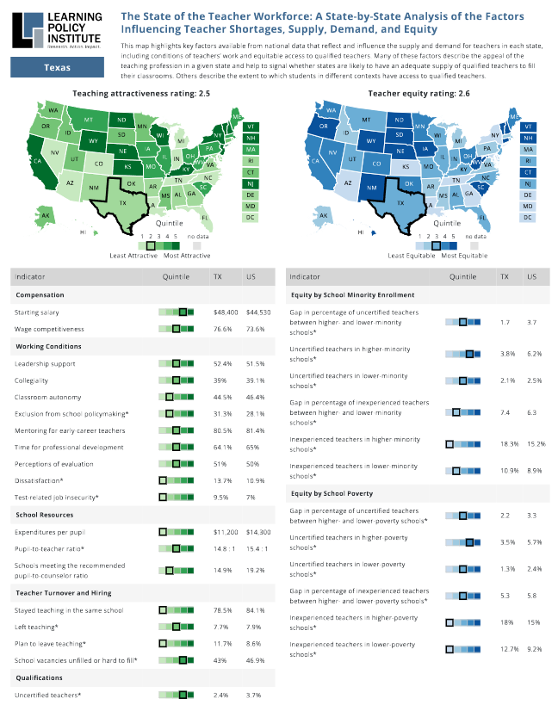
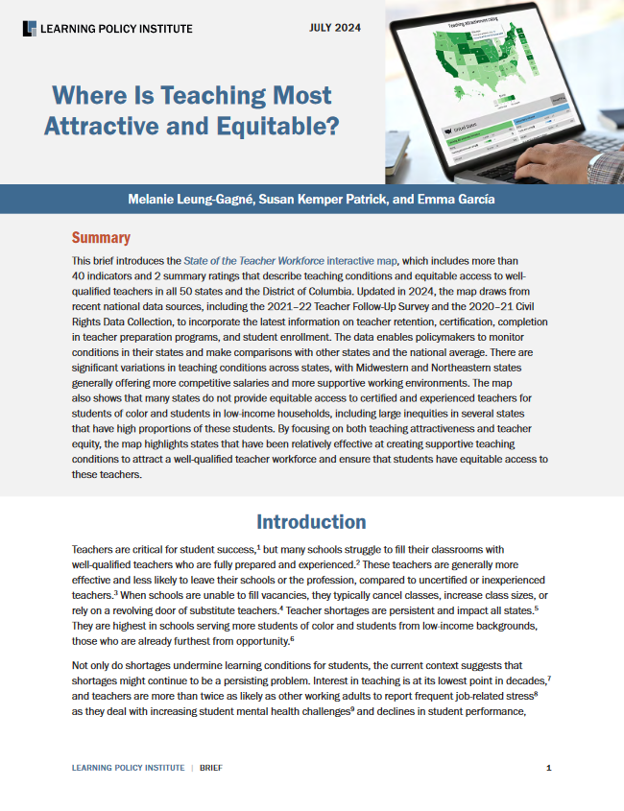
Accompanying resources
State-specific PDFs
Brief
Blog
Notes:
Before I go into some specific datapoints, I wanted to highlight some additional resources, including PDFs for each state that you can download, that shows all of the indicators in two pages. There’s also a blog authored by Linda Darling-Hammond, our president, that links these datapoints to policies in several states, so I encourage you to check that out.

Slide 15
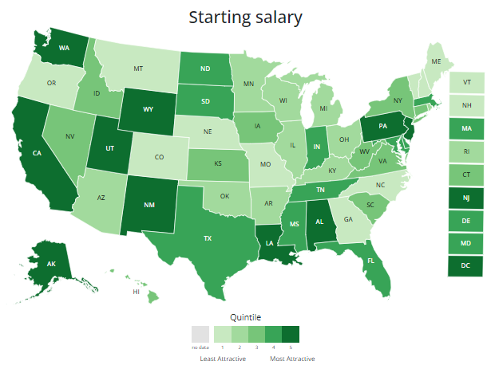
Starting salary
Average starting teacher salary, adjusted for cost-of-living differences
United States: $44,530
Lowest: 4 states below $40,000 (CO, MT, NH, OR)
Highest: 8 states plus D.C. above $50,000 (AK, DC, LA, PA, NJ, NM, UT, WA, WY)
Source: National Education Association, 2022-23
Notes:
Let’s start by looking at starting salary, which we know is key to teacher recruitment and retention. Higher salaries can increase the quantity and quality of the candidate pool for open teaching positions, and many surveys of teachers have found that increased salaries are teachers’ preferred strategy to increase retention. As we’ll hear about today in the panel discussion, there have been numerous recent pushes at the federal, state, and local level to increase teacher salaries, not just for new teachers but for teachers at different stages of their career as well.
The map offers information on the average starting salary for a teacher with a bachelor’s degree in 2022-23, adjusted for cost-of-living differences across states. <CLICK>
The average starting salary nationally is $44,530.
States with the lowest salaries include Montana, Colorado, New Hampshire and Oregon, where starting salary is below $40,000 <CLICK>
There are 8 states plus D.C., all in dark green, with starting salaries above $50,000. <CLICK>

Slide 16
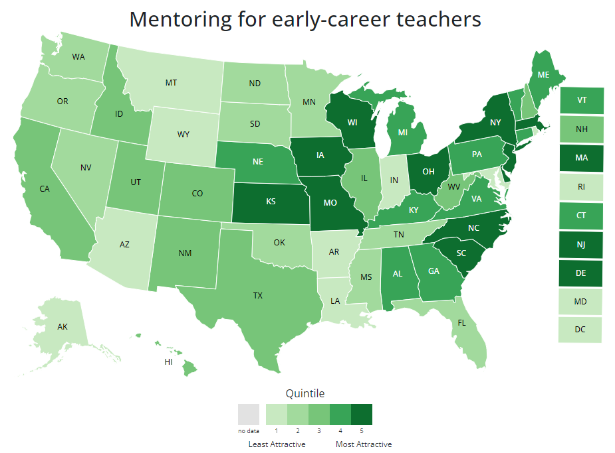
Mentoring for early career teachers
Percentage of early-career teachers (i.e., in first five years of teaching) who reported having a mentor assigned by their school or district in their first year of teaching.
United States: 81%
Lowest: 4 states plus D.C. below 60%
(AR, DC, IN, LA, RI)
Highest: 5 above 95%
(DE, IA, KS, MO, SC)
Source: National Teacher and Principal Survey, 2020-21
Notes:
Our map also examines access to mentoring as you know, supporting early careers teachers is particularly important, those first years are especially hard and research shows that mentoring helps to keep them in the classroom and support their improvement. CLICK
o
oOverall, about 4 in 5 new teachers nationally report access to these mentors. As you can see, this ranges widely across the country, with 4 states plus D.C. having less than 60% of early career teachers reporting mentoring while 5 states have over 95% of their early career teachers reporting mentoring.

Slide 17
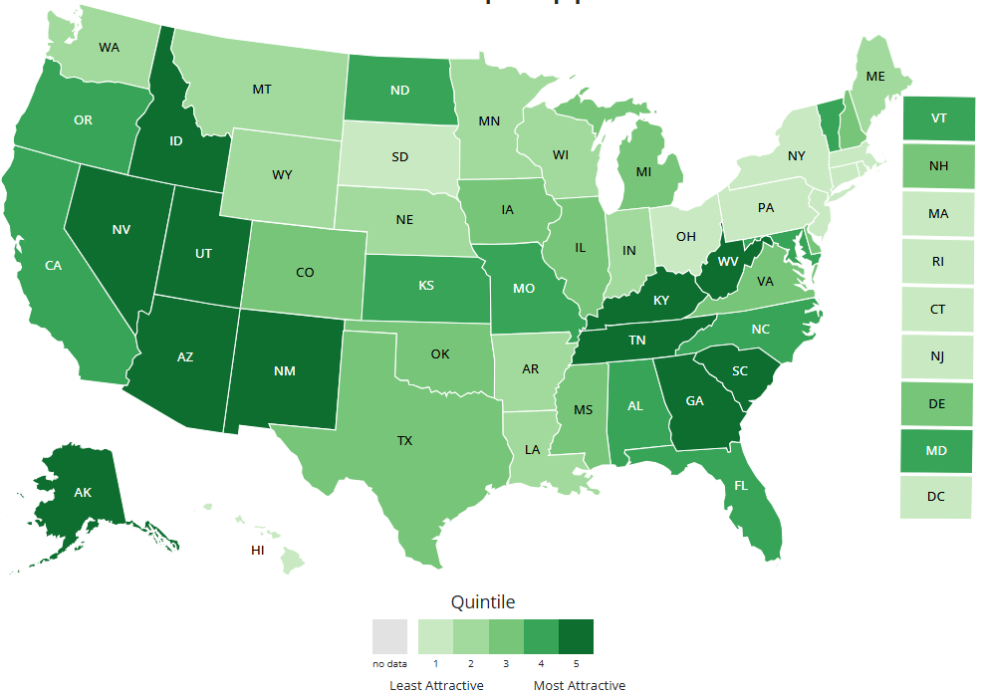
Leadership support
Percent of teachers who strongly agree their “school administration’s behavior towards the staff is supportive and encouraging.”
United States: 51.5%
Lowest: 6 states below 45% (CT, HI, MA, NJ, OH, PA,)
Highest: 3 states above 60% (ID, KY, UT)
Source: National Teacher and Principal Survey, 2020-21
Notes:
Next, we want to discuss leadership support. Numerous studies of teacher retention have found that strong and supportive school leadership is often the most important factor in retaining teachers in their school. There are many things that states can be doing to ensure that school leaders are well-prepared and well-supported so they, in turn, can support teachers. These state policies can include setting high standards for administrator preparation and licensure, incentivizing talented teacher leaders into the leadership pipeline, and providing ongoing state-level funding and administrative support for leadership training and coaching for new school leaders.
The map offers one metric capturing leadership support, which is the percent of teachers per state that strongly agree that their school administration is supportive and encouraging <CLICK>
Nationally, this is just over half of teachers who indicate such support.
There are 6 states in which less than 45% of teachers report this level support, all shown in the light green<CLICK>
In Idaho, Kentucky, and Utah, all in dark green, more than 60% of teachers report this support. <CLICK>

Slide 18
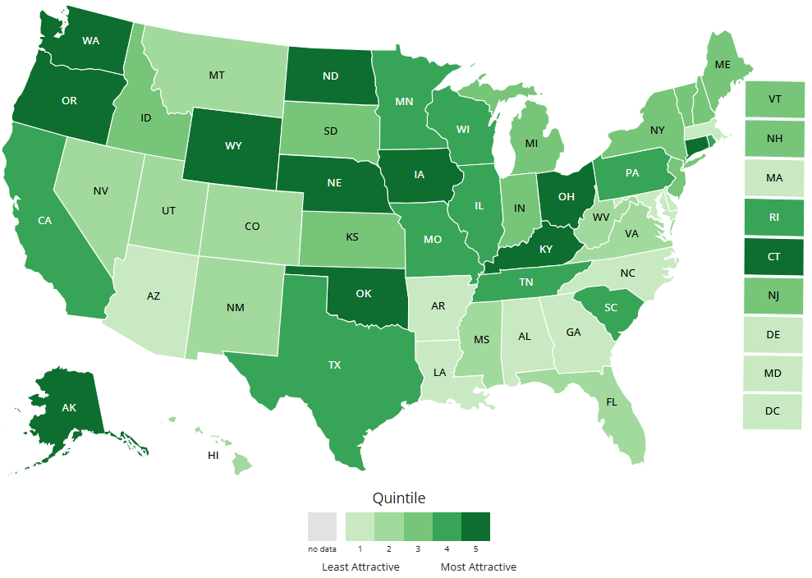
Uncertified teachers
Percent of teachers who have not met state certification requirements
United States: 3.7%
Lowest: 6 states below 1% (IA, ND, NE, OH, OK, WY)
Highest: 4 states plus DC above 10% (AZ, DC, DE, NC, LA)
Source: Civil Rights Data Collection, 2020-21
Notes:
Next, we wanted to talk about teacher certification. States set certification requirements for teachers and there are many state policies that can both set high professional standards for teachers and incentivize teaching candidates to meet these standards. Teachers who are fully certified have higher retention and tend to be more effective, compared to teachers who are not fully certified because they are completing preparation while teaching or who have little to no preparation and are teaching on emergency-style permits. The webinar on Thursday will be focused on strategies to create high quality and affordable pathways into the profession, like teacher residencies, that can ensure teachers are entering the profession fully certified and well prepared.
This map data shows the percent of FTE teachers who have not met state certification requirements. Nationally, this is estimated at just under 4%, with many states with extremely low percentages of uncertified teachers, including 6 states under 1% (all shown here in dark green).
On the flipside, 4 states plus DC have more than 10% uncertified teachers according to this metric, all shared here in light green.

Slide 20
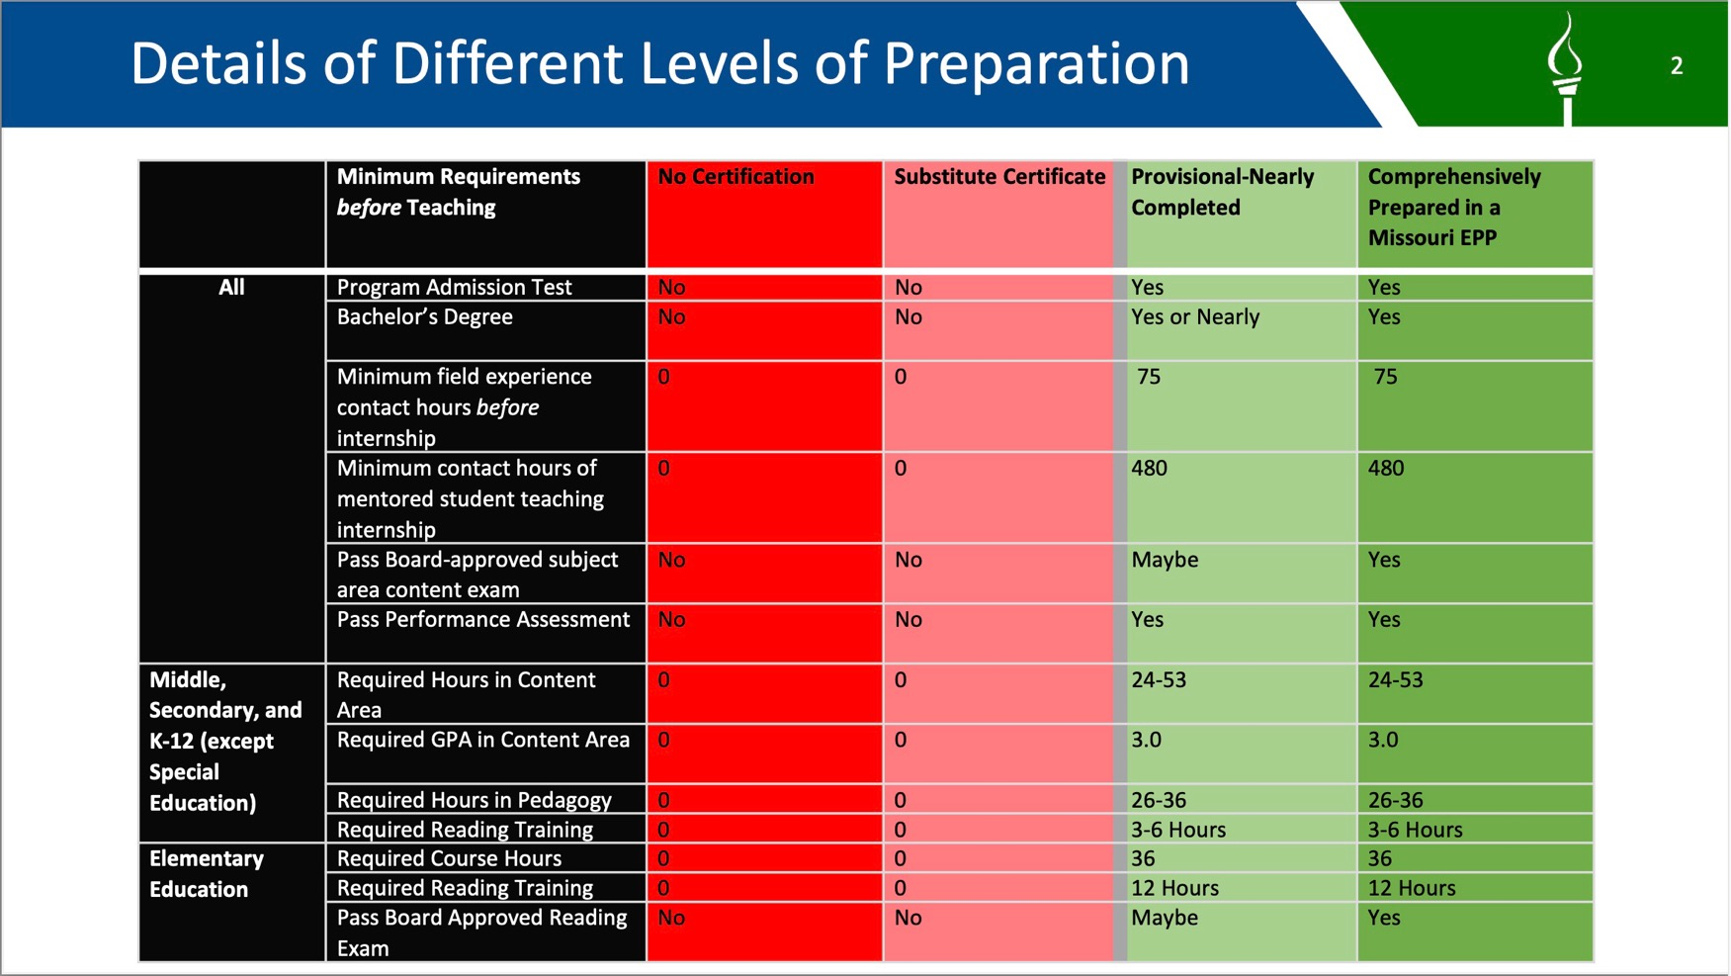

Slide 21
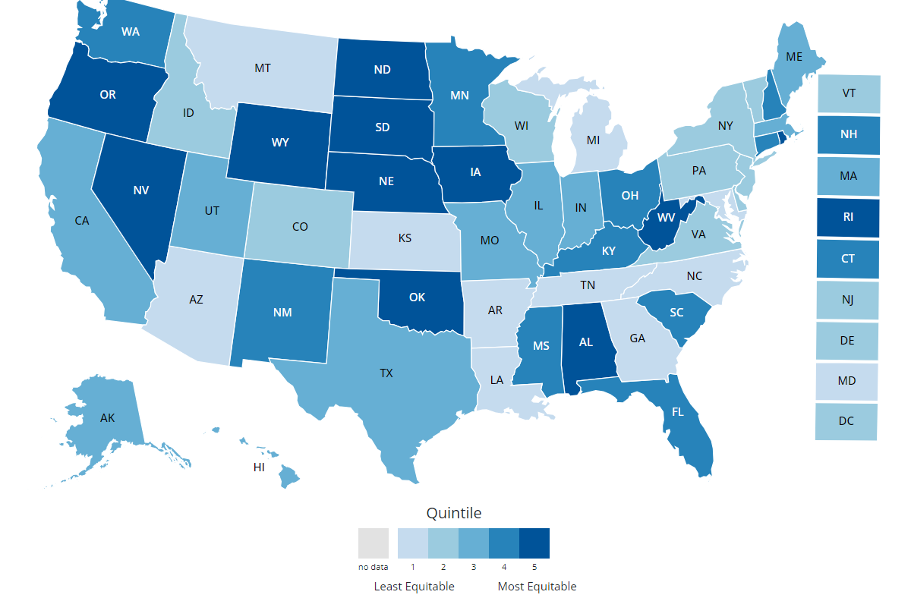
Equitable distribution of well-qualified teachers
Difference in percent of uncertified teachers between high and low poverty schools
United States: 3.3 pp
High poverty schools: 5.7%
Low poverty schools: 2.4%
Highest: 7 states with gaps above 6.5 pp (AR, GA, KS, LA, MD, MI, TN)
Lowest: 6 states with negative gaps
(ND, NV, OR, RI, SD, WV)
Source: Civil Rights Data Collection, 2020-21
Notes:
The map includes numerous teacher equity indicators because it is important that all students have access to well-qualified teachers. Decades of research has found that students of color and students from low-income households are more likely to be taught by teachers who are not fully certified and inexperienced teachers. States can help address this inequitable distribution by investing in targeted recruitment and retention efforts in schools with higher teacher shortages and higher turnover. These can include loan forgiveness and service scholarship programs to attract and retain new teachers, incentive programs for National Board Certified teachers to stay in high need schools, and more equitable state funding across schools to improve resources and working conditions at high needs schools.
In this slide, we are showing one of those equity indicators which captures the distribution of uncertified teachers based on school poverty levels. As a baseline, a state where there the share of uncertified teachers in high-poverty schools is equal to the share (of uncertified teachers) in low-poverty schools would have a 0 on this indicator. Higher numbers indicate more inequitable distributions of teachers. <CLICK>
In US, the gap is 3.3 percentage points, which results from comparing the 5.7 (percent) and 2.4 percent of uncertified teachers in high versus low poverty schools. <CLICK>
There are 7 states with gaps that are more than double the national average, these are all shown in light blue.
There are 6 states with negative gaps, indicating the percent of uncertified teachers is actually higher in lower poverty schools.
With than, I will turn it over to my colleague Susan Patrick

Slide 22
Policy Implications
Notes:
So, I know we both just shared a lot of information at you all, so we are happy to clarify any questions in just a second, but before I do I will also share a bit about what all these figures and statistics mean when it comes to advancing policies that address teacher shortages.

Slide 23
Policy Strategies to Support Access to a Stable, Well-Prepared, and Diverse Educator Workforce
Improve service scholarship and loan forgiveness programs
Increase affordability of comprehensive preparation
Provide high-quality mentoring for all beginning teachers
Bolster teacher’s net compensation
Improve working conditions
Notes:
There are a few key strategic levers that can help support equitable access to a stable, well-prepared, and diverse educator workforce, and I wanted to share some with you all today.
First, To support teacher recruitment and retention, one main lever is to reduce the cost of prep, including thorugh…
service scholarship amounts to provide upfront aid to reduce or eliminate the need to borrow , as well as
loan forgiveness programs for educators, which cancels accrued student loan debt for teachers after certain number years of service,
Both of which exist at both the state and federal levels.
[advance] If implemented properly, these programs are part of the work to expand the affordability and availability of comprehensive preparation, which as pointed earlier has been shown by research to improve teacher effectiveness and retention. Here, there are roles from the federal level to administer formula grants or to fund competitive grants that support comprehensive preparation, down to the local district level to contribute to a clinically intensive and practice-based experience. We see features of comprehensive prep programs in models like paid teacher residencies, as well as some grow your own models.
[advance] Once candidates enter the classroom as a teacher of record, their preparation can be further buttressed by investments into beginning teacher mentoring and induction programs. One thing to note here is that currently, the requirements to have and the investments into M&I programs vary largely by state. For example, California requires new teachers with a preliminary credential to complete a two-year state-approved induction program, which usually involves having a mentor teacher.
[advance] One major lever at the state and local level are to address teachers’ compensation, and this can take the form of increasing minimum salaries throughout the salary schedule, equalizing compensation across districts or subject areas, which can could take the form of targeted boosts for the schools or districts in the state that are considered in highest needs. However, there are other ways to think about improving a teacher’s net compensation, through avenues like tax credits or housing subsidies.
[advance] Finally, improving working conditions contribute largely to a teacher’s decision to stay, move schools, or leave the profession entirely. Things ranging from a well-prepared and supportive school leader to a teacher’s workload, availability of support staff, and routinely assessing working conditions to make decisions about teaching, are all levers, especially at the local level, to consider.
In summary, these research-based policy strategies aim to improve the state of the teacher workforce with respects to teacher shortages and teacher diversity. Additionally, taking this one step further, through teachers, these strategies can also impact students with respect to learning outcomes and growth, opportunities to learn, and learning environment stability, among others.
Retention is as important as recruitment.
Reducing attrition is a function of preparation, mentoring, salaries and working conditions.
We provide tools for states to evaluate and address these factors.
New strategies like residencies can provide long-term solutions.

Slide 24
National Board Certification
Supports teacher retention and student learning.
Supports teacher leadership and expertise.
State Policy:
MD: Annual $10,000 salary increase. Additional $7,000 for teachers staying or moving to low performing schools.
AL: $5,000 annual stipend; additional $5,000 for working in certain subject areas and schools.

Slide 25
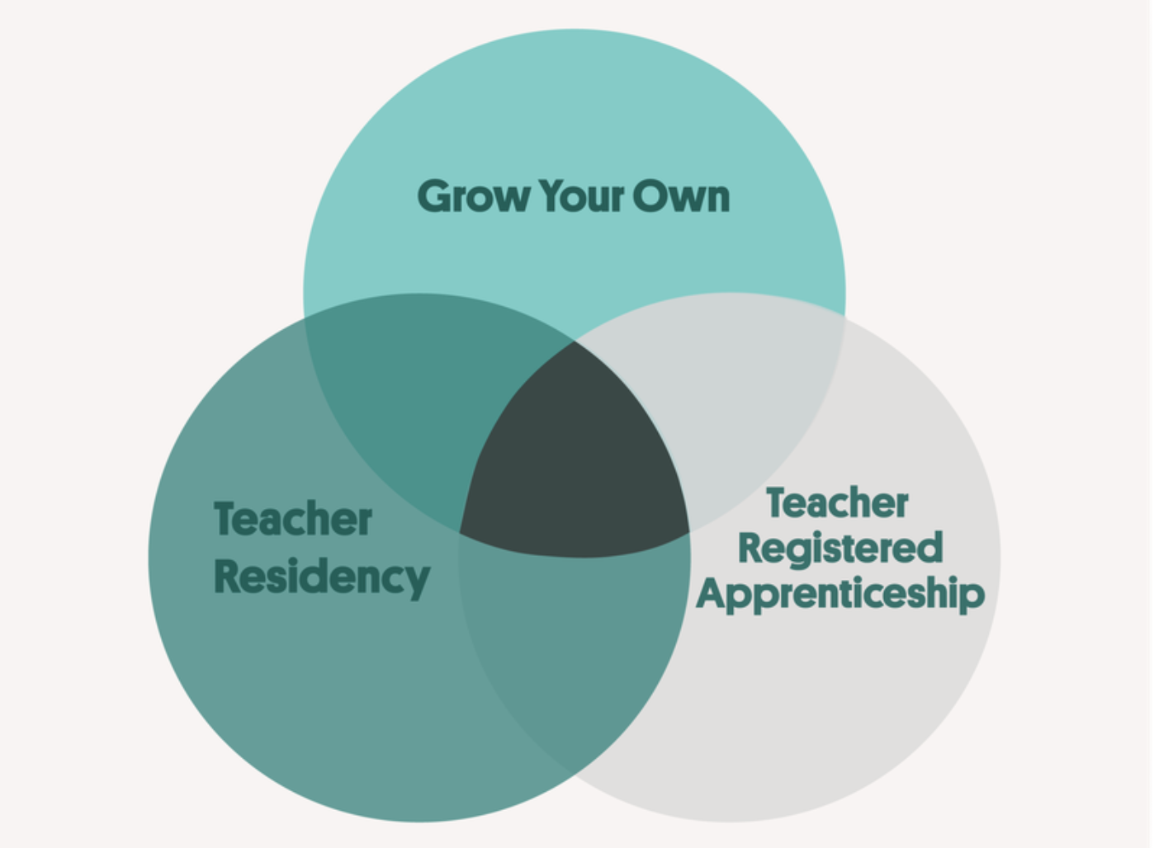
Broadening Access to High-Quality & Affordable Preparation
High-Retention Pathways into Teaching
Teacher Residencies
Grow-Your-Own Programs
Registered Apprenticeships
Service Scholarships/Loan Forgiveness
Reduce barriers to accessing high-quality preparation, not standards
Source: Garcia (2024, Feb. 6) What's the Difference Between GYO, Teacher Residency, and Teacher RA?
Notes:
So, a key policy question for state and system leaders to think about is how to broaden access to HQ and affordable preparation…
Research points to the key drivers of shortages, but there’s also a growing evidence base on policy strategies to address them.
This includes what we call high-retention pathways into teaching,
through pathways such as teacher residencies and Grow-Your-Own models, as well as a newer strategy, registered apprenticeships into teaching. note that there are important similarities and overlap in these strategies.
States can also cover most or all of the cost of teacher preparation—in exchange for a commitment to teach in a high-need field or school (including rural schools), by investing in service scholarship or loan forgiveness programs. The notion that “If you will teach, we will pay for your education” can be a powerful recruitment AND retention tool. As I mentioned, 37% of teachers nationally still carry student loan debt, so this could be a powerful strategy to retain the existing teacher workforce.
All of these strategies serve to broaden access to preparation and reduce barriers to entry—especially financial ones…as opposed to lowering standards for teachers, which can too often seem like an easy fix to solving teacher shortages.
Teacher shortages have been addressed in counterproductive ways
Unprepared teachers are typically hired to fill vacancies
These teachers are less effective and leave at higher rates
This produces churn in high-need schools that further undermines student achievement and creates an unstable environment
Replacing teachers absorbs the resources needed for mentoring and support
Residencies stop the vicious cycle by preparing teachers who are effective and stay, stabilizing schools and districts, and improving learning

Slide 26
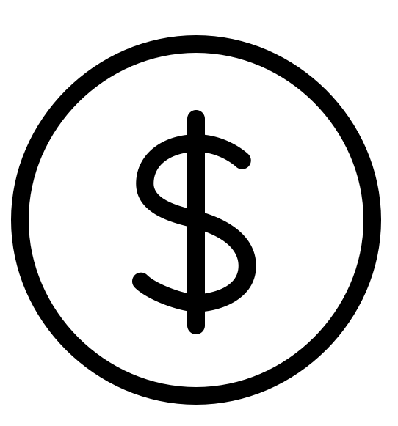
Key Characteristics of Teacher Residencies
LEA
Improved teaching & learning
+
Selective Cohort
Full year residency w/ expert mentor teacher
~ 900 hours clinical experiences
&
Integrated coursework
→ BA + Credential, often a MA
Early career mentoring
Educator Prep Program
Stronger teacher preparation
Teaching Commitment
+ sometimes others
(e.g., union, CBO)
Notes:
Features of High-Quality Residencies:
Strong partnerships between districts and preparation programs
A full academic year of residency working alongside an expert mentor teacher while completing credential coursework
Financial supports for residents’ tuition and living expenses
Induction and mentoring support following the residency year
Compensation and training for expert mentor teachers
Selection to address critical workforce needs
Service commitment to district (3-5 years)

Slide 27
State Support for Teacher Residencies
Washington:
Investment of ESSER + other state funds in residencies: WEA, Western Washington and Central Washington Universities.
Montana:
The Residency Demonstration Project prepares teachers in rural areas through undergraduate coursework and a yearlong residency.
Residents receive a $14,000 stipend, partial tuition support, and district-provided housing.
New York:
New York State Department of Labor Teacher Residency program provides a $30 million “last dollar” investment to support residencies.
Pennsylvania:
The Pennsylvania Department of Education (PDE) distributed $5.8 million under Title II, Part A to seed teacher and principal residencies across the state.
California:
California has invested more than $670 million over five years to support teacher residencies.
Per resident state grant of $40,000 with local match; minimum stipend of $20,000.
WA
ME
VT
NH
MA
AK
MT
ND
Delaware:
Pilot program provides stipends that must be at least $25,000 for residents in schools with high teacher turnover rates and $20,000 for residents in state shortage areas.
OR
MN
NY
ID
WI
MI
RI
SD
MD
NJ
CT
WY
PA
DE
NE
IA
OH
IL
IN
WV
Washington D.C.
New Mexico:
In 2019, the legislature allocated $1 million to launch a teacher residency pilot program.
In 2022, an additional $15.5 million was appropriated for the program.
Includes $35,000 per year for residents.
NV
UT
VA
CA
CO
KS
MO
KY
NC
Indiana:
Between 2019 and 2024, the Indiana General Assembly invested over $3 million in state funds in the Teacher Residency Grant Pilot Program
Provides $15,000 per teacher resident to cover stipends to residents and mentor teachers.
TN
SC
AZ
OK
AR
NM
AL
GA
MS
HI
TX
LA
FL
Texas:
More than $90 million in ESSER funds.
The High-Quality, Sustainable Residency Program provides districts with $20,000 per resident to cover their living expenses.
Provides additional $5000 per resident to be used by the LEA for programmatic support.
West Virginia:
State policy requires every individual pursuing teaching through a traditional teacher preparation program to complete a yearlong residency by Fall 2024.
The state is using federal ESSER funds to provide $2000 stipends to residents
Policy allows residents to substitute teach in their host school up to one day per week.
Mississippi:
First state-run teacher residency program.
Residents receive a full scholarship and complete a master’s degree program in elementary and special education.
Notes:
Ryan
A report we released back in July of this year, synthesizes trends from these states including Arizona, California, Delaware, Indiana, Mississippi, Montana, New Mexico, New York, Pennsylvania, Texas, Washington, and West Virginia
it is important to note different policy mechanisms through which states support residencies. Five states highlighted in this report have enacted legislative language to codify financial support and specific requirements for residency programs (California, Delaware, Indiana, New Mexico, and New York), while six have sought to launch programs through state agencies (Arizona, Mississippi, Montana, Pennsylvania, Texas, and West Virginia).
We will hear more about two of these states, California and Texas, when we shift to our panel in a moment…
Texas a combined investment of almost $100 mil, 90 from ESSER and 7.5 from state allocations
California has invested more than $670 million over five years to support teacher residencies targeted to address high-need fields
Policies to Support Partnerships
Capacity-Building and Planning Grants (California, Indiana, and Pennsylvania)
Funding Staff to Support Residencies (New Mexico)
Funding for Operations (California and Texas)
Who gets the funding? District or Preparation Programs?
Financial Support and Incentives
Wide range of approaches to providing incentives and financial support to residents.
Strategic Staffing and Flexible Roles (Delaware, West Virginia)
Stipends for Residents
Stipends range between $2,000 to $35,000
Incentives and Support for Mentors (Indiana)
Additional incentives for housing, health insurance, transportation, books, and testing fees.
Technical assistance…Establishing Statewide TA Centers (California)
Establishing Regional TA Centers (Texas)
Funding TA Providers (e.g., US Prep, NCTR, Prepared to Teach)
Creating Collaborative Structures (California Residency Lab)

Slide 28
Grow-Your-Own Programs
High school pathways
2 + 2 programs
Programs for paraprofessionals, classified staff, expanded learning staff, substitutes, early learning
“Umbrella” term
Recruiting from the community
Individualized supports, meeting candidates where they are
Career ladders/meeting staffing needs in other areas

Slide 29
Registered Apprenticeships into Teaching
Registered programs must have:
Paid apprentices
On-the-job mentorship
Related instruction
Nationally recognized credentials
Notes:
I think most of you on this call know this, but just to level set:
Registered apprenticeships have the following distinguishing features.
Apprentices are paid on a progressive wage scale.
They receive on-the-job mentorship, in this case from a teacher of record.
They receive related instruction, in this case from an education preparation provider at an institution of higher education.
They receive a nationally recognized credential, in this case a degree and/or teaching license.
Teacher residency is really similar to apprenticeship, for example, with a key difference that residents do not necessarily have to be paid, and cannot access apprenticeship funding.
Grow Your Own programs may also overlap heavily with apprenticeship. The distinguishing feature of GYO is that they recruit locally, and typically offer wraparound supports. But they also don’t need to be paid and don’t necessarily require full-time on the job training.

Slide 30
A final policy consideration for states
Importance of data systems, evaluation, and continuous improvement to track impact of federal, state, and local policies & investments in high-quality and affordable pathways into education

Slide 31
Questions?

Slide 32
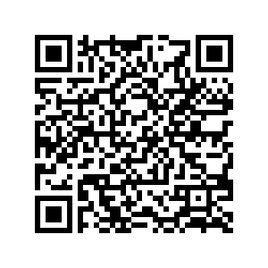
Thank You!
Ryan Saunders, rsaunders@learningpolicyinstitute.org
Visit our website for additional resources!

