Slide 1
Critical Minerals and America’s Future
Presentation by Eric Miller
to the
Senate Presidents’ Forum
Girdwood, Alaska
September 18, 2024

Slide 2
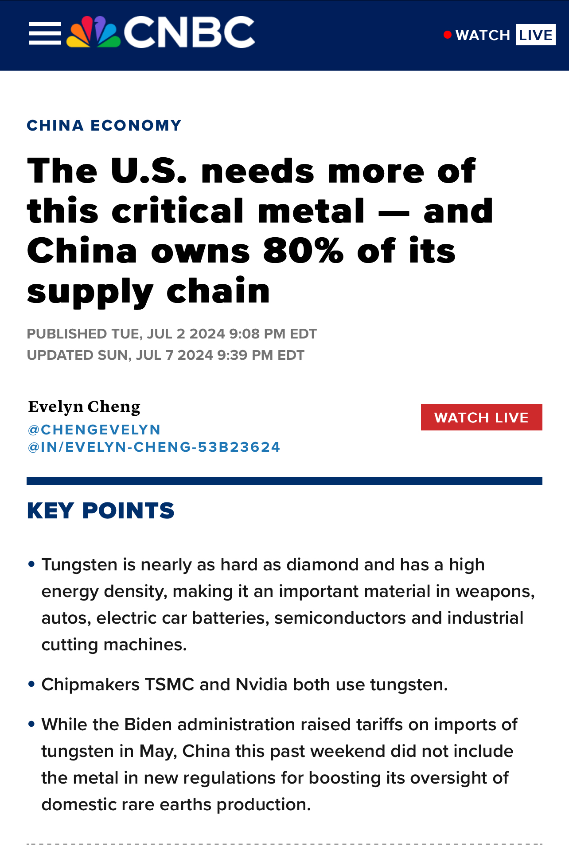
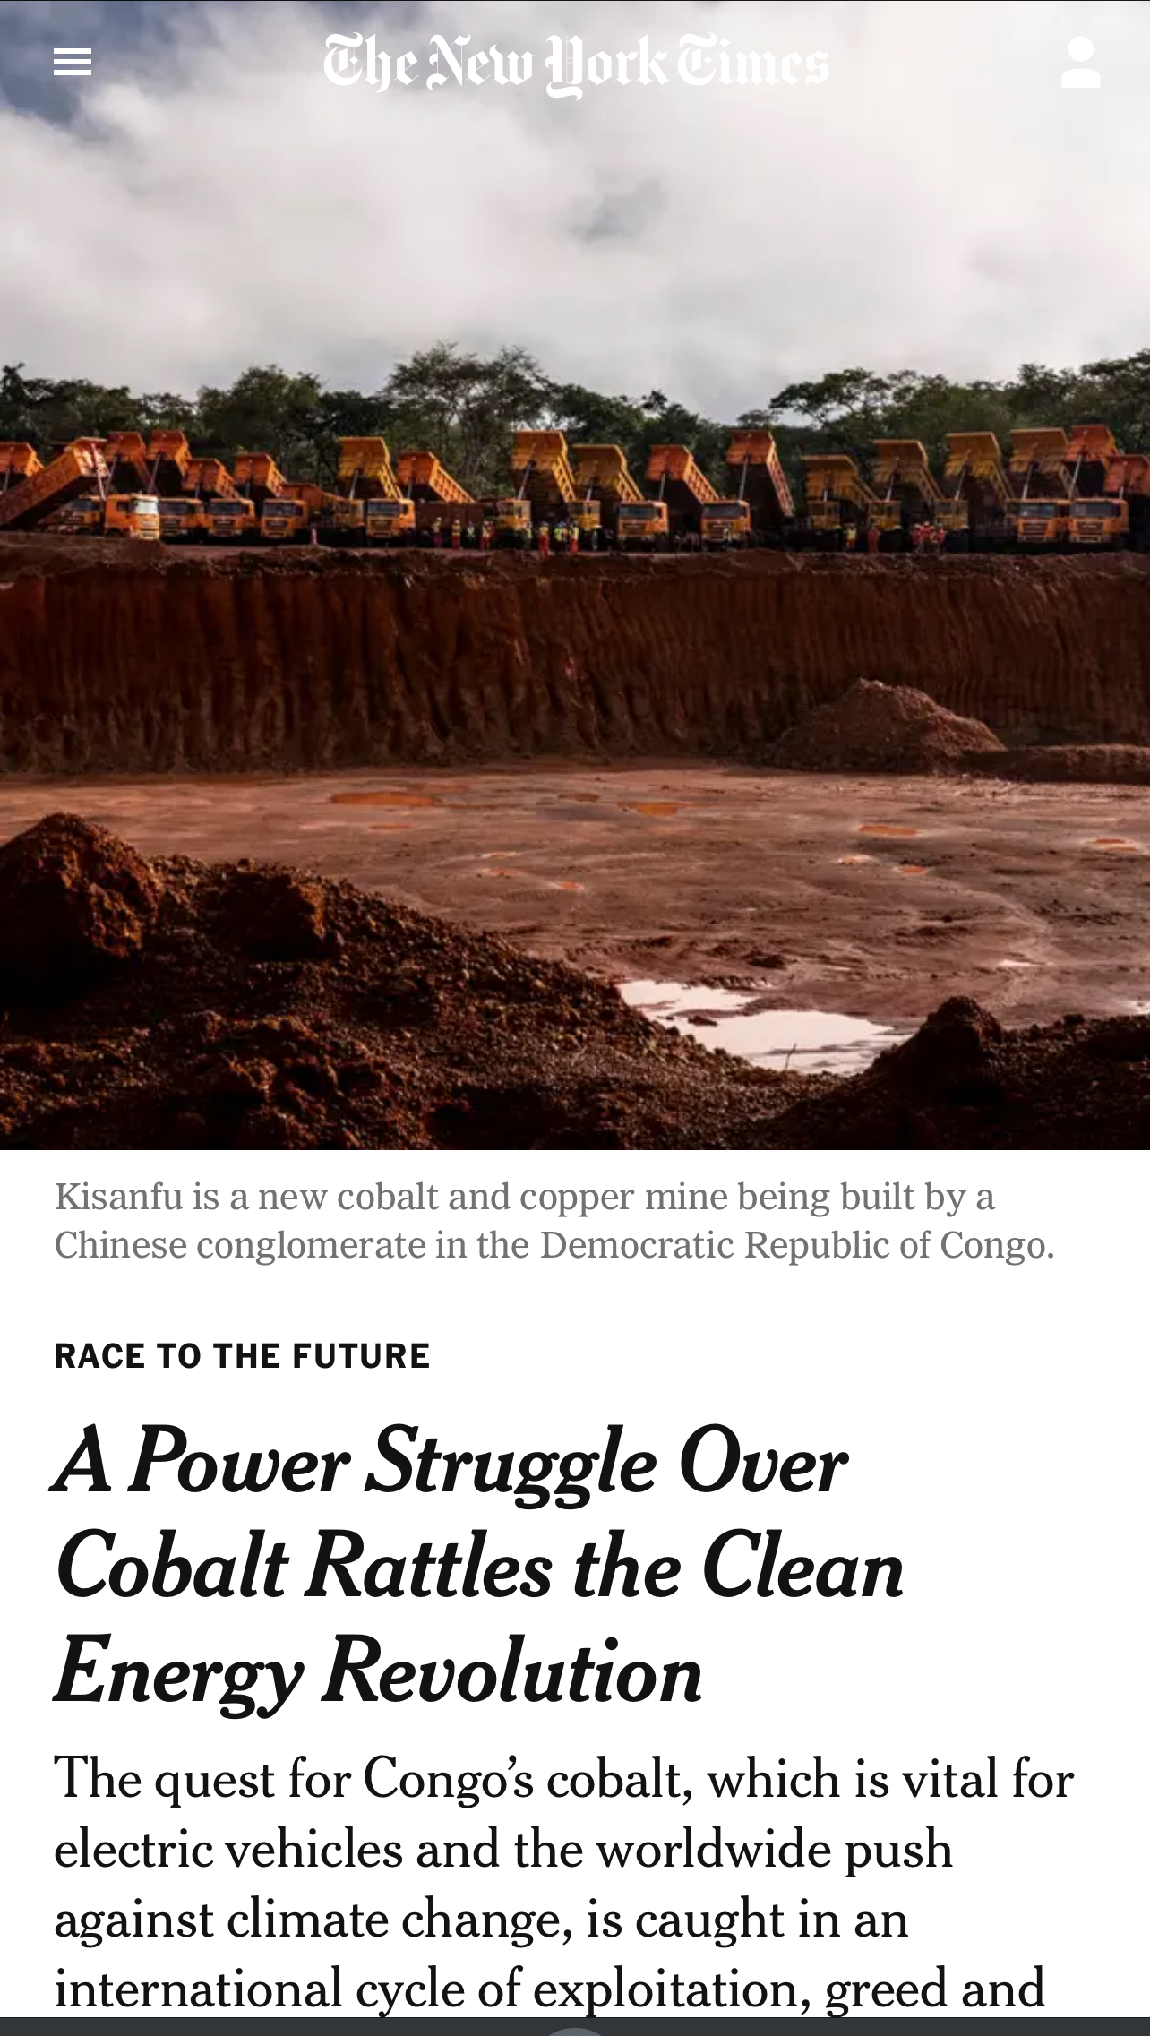
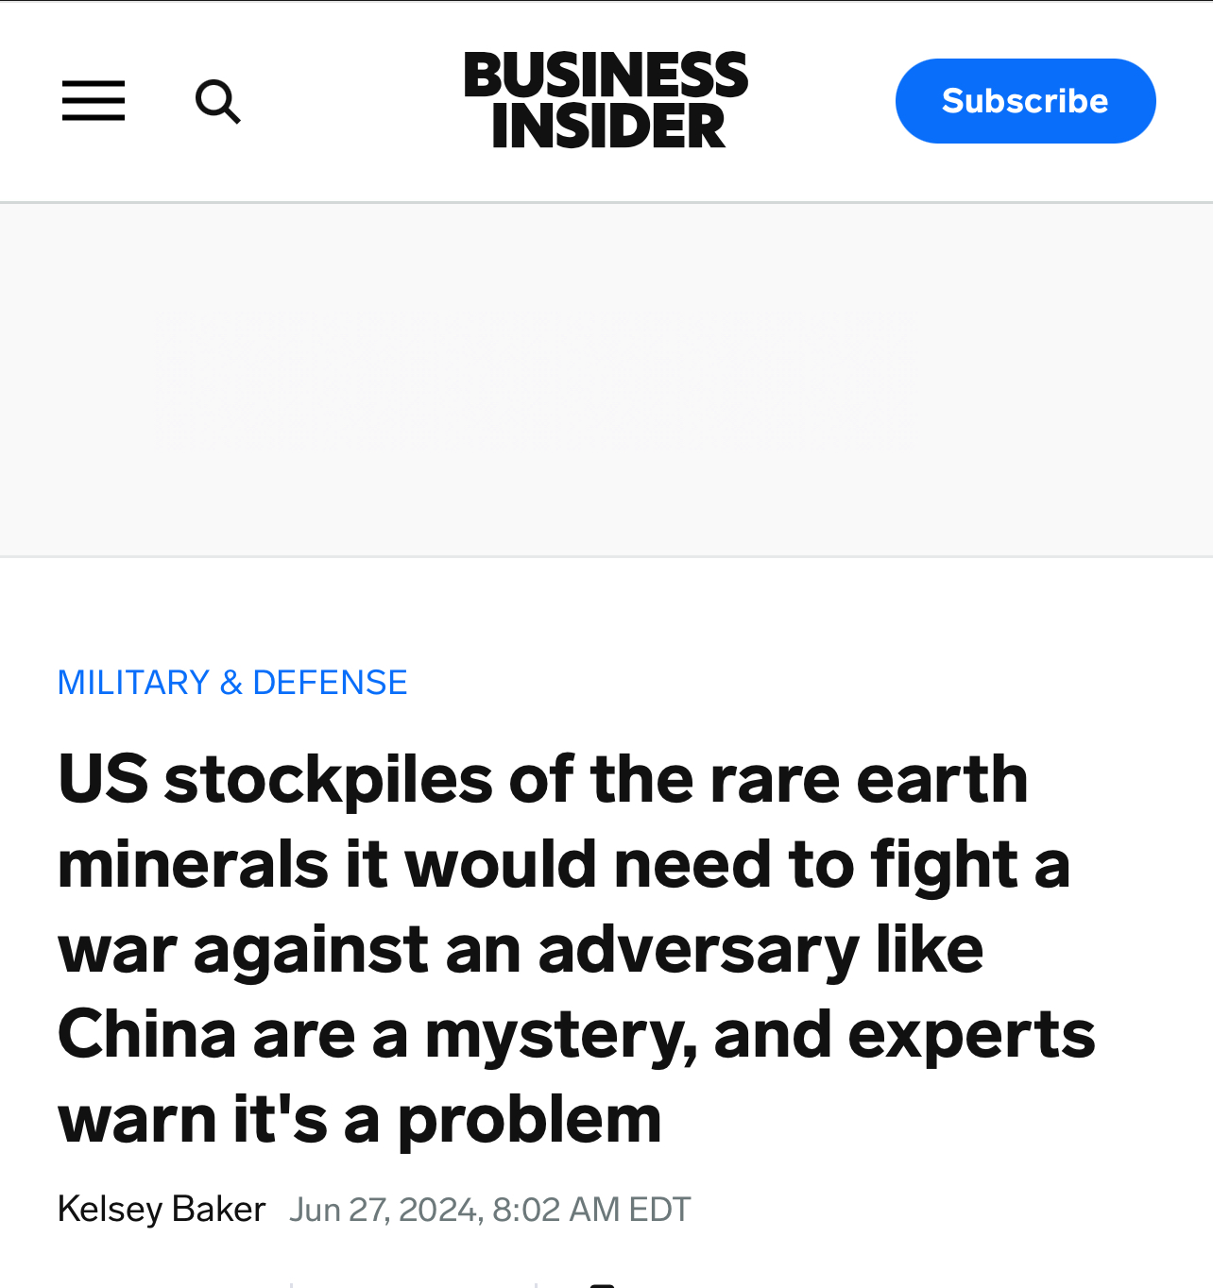
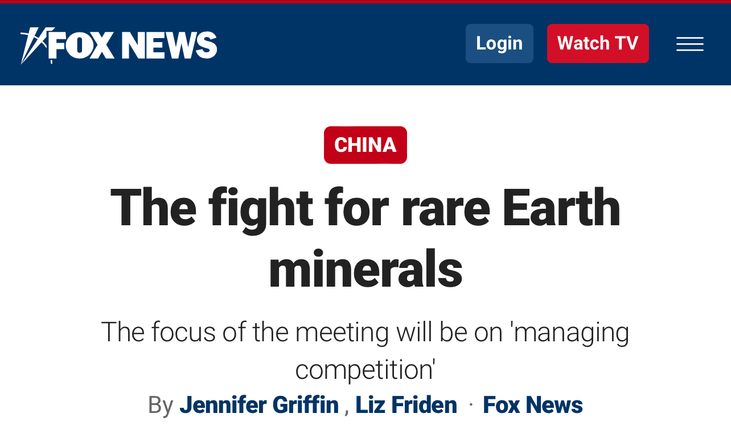
A Critical Issue

Slide 3
A Foundational Activity
If it is not grown, it is mined.
Mining is almost as old as humanity.
But how we do it matters greatly!
Celtic Sword
(Iron blade. Copper alloy hilt)
60 BCE
Image: Metropolitan Museum of Art.
https://www.metmuseum.org/art/collection/search/470298?img=1

Slide 4
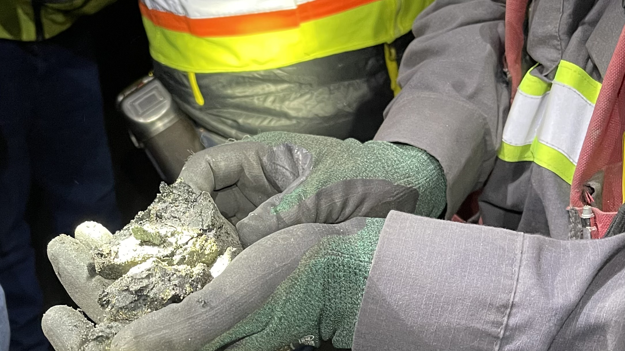
What Are Critical Minerals?

Slide 5
U.S. Critical Minerals List
Mineral | Main Uses
Aluminum | Applied in almost all sectors of the economy
Antimony | Array of defense applications, lead-acid batteries and flame retardants
Arsenic | Semi-conductors; hardening bullets.
Barite | Hydrocarbon production
Beryllium | Alloying agent in aerospace and defense industries
Bismuth | Cosmetics, pharmaceuticals, ammunition.
Cerium | Catalytic converters, ceramics, glass, metallurgy, and polishing compounds
Cesium | Night vision technology; scanners; research and development
Chromium | Stainless steel; superalloys
Cobalt | Rechargeable batteries and superalloys
Dysprosium | Permanent magnets, data storage devices, and lasers
Erbium | Fiber optics, optical amplifiers, lasers, and glass colorants
Mineral | Main Uses
Europium | Phosphors and nuclear control rods
Fluorspar | Input to the manufacture of aluminum, cement, steel, gasoline, and fluorine chemicals
Gadolinium | Medical imaging, permanent magnets, and steelmaking
Gallium | Integrated circuits and optical devices like LEDs
Germanium | Fiber optics and night vision applications
Graphite | Lubricants, batteries, and fuel cells
Hafnium | Nuclear control rods, nickel superalloys, and high-temperature ceramics
Holmium | Permanent magnets, nuclear control rods, and lasers
Indium | Liquid crystal display screens
Iridium | Coating of anodes for electrochemical processes and as a chemical catalyst
Lanthanum | Produce catalysts, ceramics, glass for night vision tech, polishing compounds, metallurgy, and batteries
Lithium | Rechargeable batteries

Slide 6
U.S. Critical Minerals List
Mineral | Main Uses
Lutetium | Scintillators for medical imaging, electronics, and some cancer therapies
Magnesium | Used as an alloy and for reducing metals
Manganese | Steelmaking and batteries
Neodymium | Permanent magnets, rubber catalysts, and in medical and industrial lasers
Nickel | Stainless steel, superalloys, and rechargeable batteries
Niobium | Steel and superalloys
Palladium | Catalytic converters and as a catalyst agent
Platinum | Coatings for aerospace, catalytic converters
Praseodymium | Permanent magnets, batteries, aerospace alloys, ceramics, and colorants
Rhodium | Catalytic converters, electrical components, and as a catalyst
Rubidium | Research and development in electronics
Ruthenium | Catalysts, electrical contacts and chip resistors in computers
Samarium | Permanent magnets, as an absorber in nuclear reactors, and in cancer treatments
Mineral | Main Uses
Scandium | Alloys, ceramics, and fuel cells
Tantalum | Electronic components, mostly capacitors and in superalloys
Tellurium | Solar cells, thermoelectric devices, and as alloying additive
Terbium | Permanent magnets, fiber optics, lasers, and solid-state devices
Thulium | Various metal alloys and in lasers
Tin | Protective coatings and alloys for steel
Titanium | Fittings and attachments, alloys used in aerospace
Tungsten | Wear-resistant metals
Vanadium | Alloying agent for iron and steel in aerospace and energy storage.
Ytterbium | Catalysts, scintillometers, lasers, and metallurgy
Yttrium | Ceramic, catalysts, lasers, metallurgy, and phosphors
Zinc | Metallurgy to produce galvanized steel
Zirconium | High-temperature ceramics and corrosion-resistant alloys.

Slide 7
DOE – “Critical Materials for Energy”
Some notable differences, including Copper and Uranium.

Slide 8
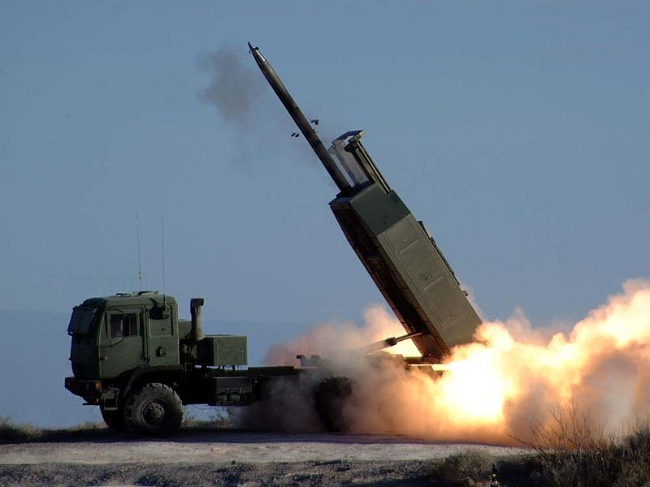
Select Defense Uses
Tungsten
(HIMARS)
Neodymium
(Laser Range-Finders)
Cobalt
(Fighters)
Lanthanum
(Night Vision)

Slide 9
Critical Minerals: A Small but Important Segment
Top Forty Mining Companies: Share of Revenue by Commodity
Source: Mine 2023 Report. PWC

Slide 10
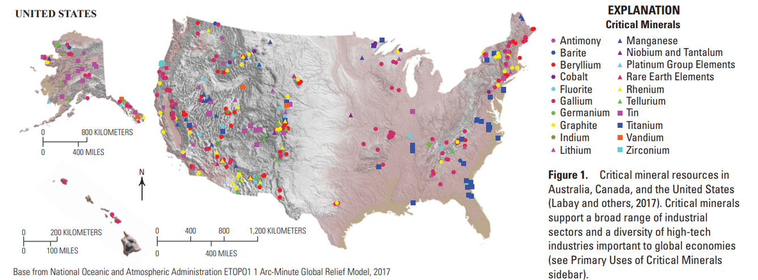
Select United States Critical Minerals Locations
Source: U.S. Geological Survey

Slide 11
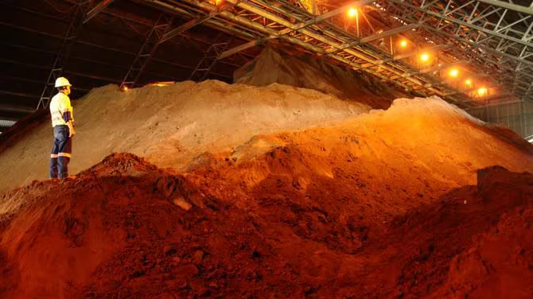
Key Vulnerabilities

Slide 12
U.S. Import Dependence for Select Critical Minerals
Source: U.S. Geological Survey

Slide 13
Where is America? Refining Capacity for Critical Minerals
Source: International Energy Agency

Slide 14
Critical Minerals Demand
APS Scenario, Global Critical Minerals Outlook 2024, IEA

Slide 15
Recycling: All of the Above
Recycling will be key to meeting future demand, it but cannot come close to meeting all requirements on its own.
Economics are crucial. Many materials today aren’t worth recycling.
Industry needs standards, especially around labelling.
1. Collect spent cells
2. Crush spent cells
3. Chemically process spent cells to retrieve metals
4. Use metals to produce cathode and anode active material later used in the manufacture of cells.
Typical Battery Metals Recycling Process

Slide 16
Price Declines Since 2022 Peak
Source: Trading Economics

Slide 17
National Defense Stockpile: Nothing in the Bank
Cobalt
1990: 24,100 MT
2024: 300 MT
U.S. Market Size for Cobalt
~20,000 MT per annum
By contrast, per close market watchers, China’s stockpile agency has purchased an estimated 5000-10,000 MT in the last two years.

Slide 18
Changing the Trajectory

Slide 19
Changing the Trajectory
Financing includes:
DOD: Defense Production Act (DPA). Title III and new Defense Industrial Base Consortium (DIBC). Typical award is $10-45 million. Supports mining projects.
DOE: Advanced Technology Vehicle Manufacturing Loan Program (ATVM). End product must be used in a vehicle (light-duty; heavy-duty; train; ship…). $40 billion in lending authority. Mining excluded. Processing included.
DOE: Tribal Energy Financing Program. ~$20 billion in authority. Mining and refining included.
DOE: Battery Materials Processing Grants. Awards typically are between $100-300 million. Supports the full advanced battery supply chain except extraction.
Ex-IM Bank: Critical minerals is a priority. “China Competition” and “Make More in America” Programs key instruments.

Slide 20
Changing the Trajectory
Policy includes:
Foreign Entity of Concern.
Minerals Security Partnership – 14 countries plus to European Union.
Resilient Resource Reserve (bipartisan support in Congress.)
Post-election – a U.S. Sovereign Wealth Fund? Both presidential candidates have voiced support. Critical minerals is the example.

Slide 21
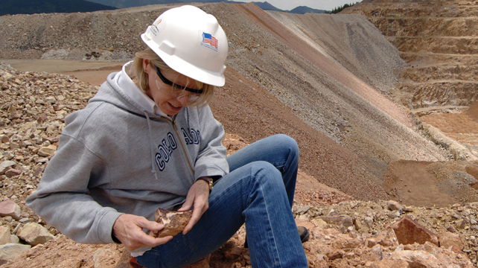
Considerations for the States

Slide 22
How Companies See Things
Mining is a risky, long-term business.
Critical minerals miners are often under-capitalized
Predictability in dealings with government is key.
Support for the major “studies” needed to get a mine built as well as for geological mapping is key.
Permitting takes years. A permitted mine with an approved Plan of Operations is valuable. For refineries, companies are looking to established industrial sites.
Good companies voluntarily pursue community benefit and other types of local benefit arrangements and partnerships.
It’s increasingly standard practice for companies to prioritize environmental stewardship. They work closely with regulators and others to achieve this.

Slide 23
Considerations for the States
Giving a mine or a refinery the green light will typically require an array of state as well as federal permits.
If the mine, for example, is on federal land, the regulatory structure will be different than if on private land. Involvement of Bureau of Land Management or Forest Service.
State Departments of Environment Quality have a big role throughout. Key to ensure that they are rigorous, but reasonable.
Coordination among regulators and transparency on timetables for decisions.
Pragmatism on minor changes to “plans of operations.”
Explore integrated mine to refinery production chain.

Slide 24
Interesting State Models
Alaska: Native American ownership
Red Dog mine. One of largest zinc operations in the world.
Land is owned by NANA – an Alaskan Native Corporation
Since 1982, operated by Teck – a major global miner
Utah: Natural Resources fund Schools
SITLA is a state agency that stewards trust lands. Generates revenue from them to fund high-quality public schools.
Permanent fund has grown from $50 million in 1994 to $3.2 billion today.
Can do land swaps with the federal government to bring lands with natural resources into SITLA stewardship. Exchanging parcels from Bear’s Ears National Park with state lands could be next.

Slide 25
Community Benefit Agreement (CBA) Development Process
Engage local partners
Initial engagement with a wide array of government, community, indigenous groups, civil society entities and NGOs
Scoping
Stakeholder Mapping
Analyse community needs assessments and development plans
Engage local stakeholders
Community dialogues, engagement meetings and Town Halls
Prioritize, Propose & Finalize
Synthesize findings and propose approach
Share for stakeholder input and approval
Formalize & Implement CBA
Sign agreement and implement the agreed deliverables

Slide 26
CBA in a broader Community Engagement Strategy
ONGOING ENGAGEMENT
Open houses, town halls, job fairs.
Participation in local, national and international events
Grievance mechanism
Information sharing
Volunteerism
Partnerships and collaborative strategies
COMMUNITY INVESTMENTS: “Community Benefits Agreement”
LOCAL EMPLOYMENT STRATEGIES
LOCAL PROCUREMENT STRATEGIES
RESEARCH & DEVELOPMENT
TAX & NON-TAX CONTRIBUTIONS
OTHER PARTNERSHIPS & COLLABORATIONS
Community Stakeholders | Indigenous Peoples | Local, State and Federal Governments
Academic and Research Institutions | Investors | Non-Governmental Organizations

Slide 27
Thank you / Questions
Eric Miller
President, Rideau Potomac Strategy Group
Tel: (202) 320-6074
E-Mail: eric.miller@rideaupotomac.com

