Slide 1

Medicaid & HR 1
Kathryn Costanza, NCSL
Senate Presidents’ Forum
September 4, 2025
Notes:
My name is . . .
Welcome to this session . . .
If you are looking for . . . Then you’re in the right place.

Slide 2


Medicaid on your mind?
Did you attend the Medicaid session at NCSL Summit?
Medicaid
Medicaid
What are your priorities?
MEDICAID
What information is most helpful to you?
Notes:
Priorities
Provisions of most interest, confusion, impact to your state?
Downstream policy effects – budgets, coverage, etc.
Info most helpful
Understanding the provisions
Timing
Scope of impact
State action?

Slide 3

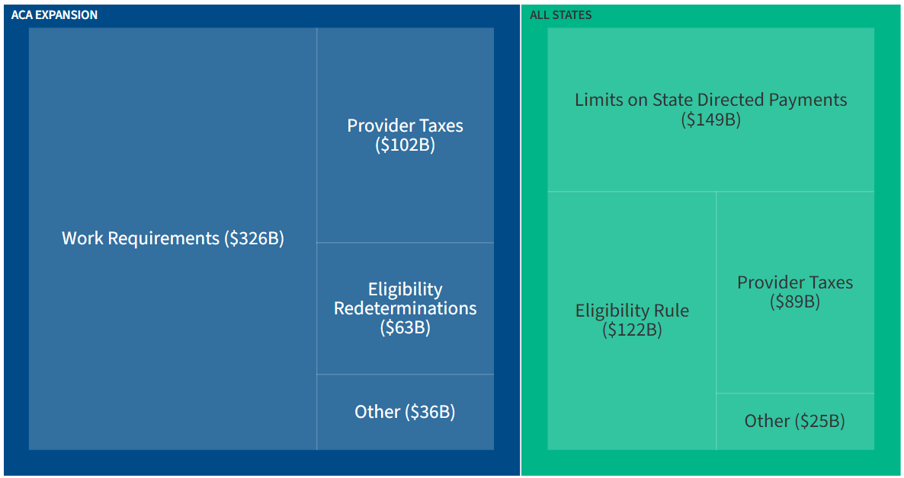
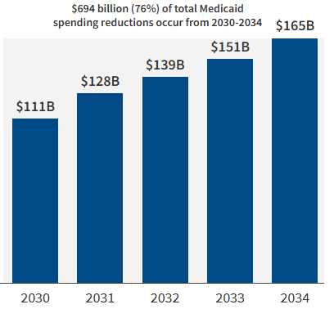


TAKEAWAYS
The Congressional Budget Office estimates HR 1 results in $911 billion in federal Medicaid savings over the next decade.
FIVE POLICIES
EXPANSION IMPACT
Five policies account for 86% of federal savings.
Expansion states alone account for over half of federal savings.
FIVE YEARS
HOSPITALS HIT
Fiscal impacts are backloaded, with 76% or $694 billion in federal savings occurring between 2030-2034.
Estimated to reduce hospital payments 18.2% or $664 billion over 10 years.
Source: Allocating CBO’s Estimates of the Federal Medicaid Spending Reductions Across States: Enacted Reconciliation Package | KFF (July 23, 2025);
Notes:
119 HR 1 includes more than 20 policies specific to Medicaid that:
Change state financing
Limit state flexibilities related to eligibility and payment
Impact coverage
Include grant funds
What these estimates can’t accurately account for? State action.
Source: Allocating CBO’s Estimates of the Federal Medicaid Spending Reductions Across States: Enacted Reconciliation Package | KFF (July 23, 2025); Senate-Passed H.R. 1: Updated Estimates on Impact to State Medicaid Coverage and Expenditures, Hospital Expenditures | SHVS & Manatt (July 1, 2025)

Slide 4



Takeaways, cont.
TIMING AND IMPLEMENTATION MATTERS
STATE IMPACT VARIES
FEDERAL SAVINGS ARE NOT NECESSARILY STATE SAVINGS
Notes:
scope of impact varies by state and policy.
Provider tax
Tax threshold
Purposes – supplemental
State flexibilities still exist
Limits on the hold harmless threshold are not per se limits on provider taxes altogether, but it does make provider taxes riskier from a state compliance perspective.
Policies address federal cost drivers in expansion enrollment, provider payments and state financing.
While some cost drivers are shared with states, impacts on state financing and implementation costs could offset state savings.

Slide 5

Primary Provisions
While every state is different, the following provisions are more likely to have significant impact on state budgets, coverage or operations.
STATE FINANCING AND PAYMENTS
EXPANSION ELIGIBILITY
OTHER ACCESS, ELIGIBILITY, AND OVERSIGHT
71115. Provider tax limits.
71116. Limits on state directed payments
71117. Provider tax waivers.
71119. Work or community engagement requirements.
71107. Increased frequency of eligibility determinations.
71120. Cost sharing.
71109 & 71110. Immigrant eligibility.
71113. Prohibited payments to certain providers.
71106. Erroneous excess payments

Slide 6



Timing
Resource: Budget Reconciliation Implementation Roadmap | Manatt & State Health and Value Strategies
2025: Apply & Plan
2026 – 2027: Implement
2028 and Beyond: Reduce & Recoup
Rural Health Transformation Fund applications (Section 71401)
Prohibiting payments to certain providers (Section 71113) (Litigation ongoing)
Limits on new state directed payments (Section 71116)
Limits on provider tax waivers (Section 71117) (Three year transition at CMS discretion)
Work or community engagement requirements (Section 71119)
Increased frequency of eligibility determinations (Section 71107)
Cost-sharing for expansion enrollees (Section 71120)
Changes to immigrant eligibility (Section 71109, 71110)
Limits on new provider taxes (Section 71115)*
Provider tax and state directed payments reductions (Sections 71115, 71116)
New HCBS Waiver (Section 71121)
Erroneous excess payments (Section 71106)
Notes:
This is a non-comprehensive list
2025 – Theme – RHTF grants / any remaining state provider tax flexibilities
This is the time to dig into to the immediate impact and put your heads together.
2026 – Eligibility implementation.
Don’t forget about mid-terms. Election year here.
2027 and beyond – this is when state financing shifts significantly and the success or struggles of eligibility implementation may impact erroneous excess payments.
Planning for this will be important.
Don’t forget – this is JUST Medicaid. Marketplace provisions going into effect simultaneously and are front-loaded in 2025 and 2026.

Slide 7
Key Questions
SCOPE OF IMPACT
STAKEHOLDERS
RESOURCES & TIMING
Who is impacted?
What is the fiscal impact?
Who is impacted?
Who has the data?
Who is implementing?
Who needs to collaborate?
Who is responsible for applying for grants?
What is the most pressing timeline for my state?
Grant timing with costs incurred?
What long-term provisions can we plan for now?
Notes:
Some questions to consider as you are evaluating the impact of HR 1 on your state.
Scope of Impact
Who is impacted (providers, beneficiaries, state agency)?
What is the fiscal impact (scope and purpose of provider taxes & state directed payments, impact on state financing, cost of implementation, savings)?
Stakeholders
Who is impacted (providers, beneficiaries, state agency)?
Who has the data needed (employers, managed care, state agencies, beneficiaries)?
Who needs to work together to implement?
Who is responsible for applying for state grants (governor, Medicaid agency, other)?
Resources & Timing
What is the most pressing timeline for my state?
Special session needed?
Grant timing with costs incurred?
What long-term provisions can we plan for now?
How could elections in 2026 potentially impact long-term planning?
Who is leading rural health transformation fund application in the governor’s office?
What stakeholders need to be at the table for implementing work requirements?
Provider tax landscape (providers, purposes and tax thresholds)
What do provider tax funds support (supplemental payments)?
What are the purposes of the directed payments we have? Are there state goals and priorities that may be affected when directed payments are reduced?

Slide 8







Key Question
What are other states doing?
NCSL Database: Health Costs, Coverage and Delivery
NCSL Snapshot: Balancing State Medicaid Budgets
Upcoming NCSL Pub: 2025 Medicaid Legislative Trends
UTAH
NEW MEXICO
KENTUCKY
VIRGINIA
WISCONSIN
COLORADO
H 51 (2024)
Requires analysis of economic and policy risks associated with Medicaid program.
SB 88 (2025)
Creates the Medicaid trust fund and the state-supported Medicaid fund.
SB 25 (2025)
Creates the Medicaid Oversight and Advisory Board.
Executive order requires stakeholder outreach related to the Rural Health Transformation Fund
2025-2027 State Budget
Increased hospital provider tax to 6%.
Governor called special session to address HR 1 beginning August 21, 2025
Notes:
Kentucky SB 25 (2025) Creates the Medicaid Oversight and Advisory Board of the Kentucky General Assembly. Established duties of the board include reviewing any change or proposed change in federal laws and regulations governing the Medicaid program and report to the Legislative Research Commission on the probable costs, possible budgetary implications, potential effect on healthcare outcomes, and the overall desirability of any change or proposed change in federal laws or regulations governing the Medicaid program.

Slide 9

Kathryn Costanza
RESOURCES
Medicaid Toolkit | NCSL
Health Costs, Coverage and Delivery State Legislation | NCSL Database
Balancing State Medicaid Budgets | NCSL
OBBBA Medicaid Policy Timeline | NAMD (Aug 2025)
Health Provisions in the 2025 Federal Budget Reconciliation Bill | KFF (July 8, 2025)
Medicaid Cuts and the States: Tracking State-Specific Estimates of the Impacts of Proposed Changes | SHVS (July 11, 2025)
Program Principal, Health Program
www.ncsl.org
Kathryn.costanza@ncsl.org
Denver, Colorado

