Slide 1
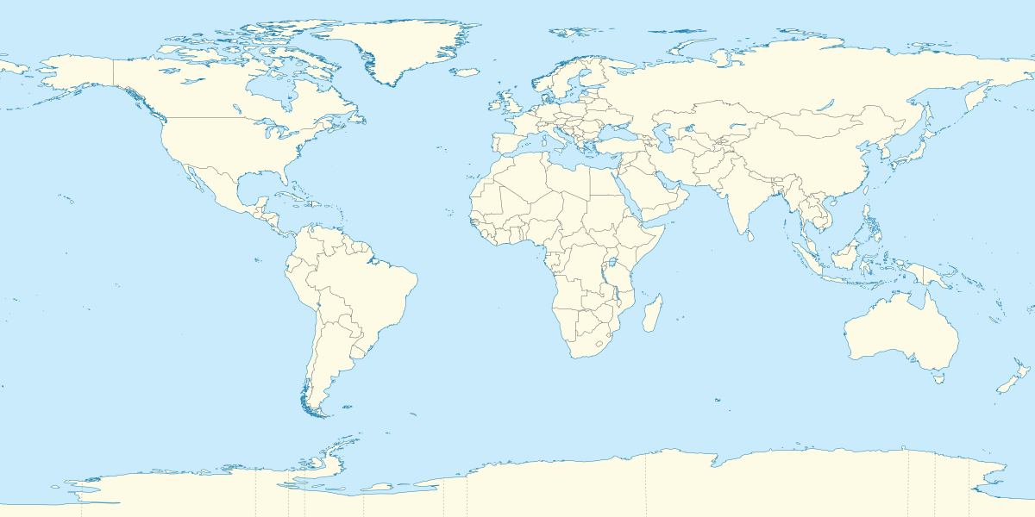
Trade Agreements and Tariffs
Senate Presidents’ Forum
September 5, 2025

Slide 2
Trump Administration Tariffs: Stated Goals
Negotiating tool
Protect US businesses
Raise revenue
Reshore jobs
Address US trade deficit
Safeguard national security and supply chains

Slide 3
Unlike previous US negotiations
Congressional role
Process requirements
Eliminate all tariffs and adopt common rules
Certainty and predictability
TPA:

Slide 4
Key Trump Tariff Actions to Date
“Reciprocal” tariffs on 69 countries
50% on steel, aluminum, and copper
25% on autos/auto parts
Fees on vessel calls after investigation of China maritime, logistics, shipbuilding sectors
25% on Canada, Mexico and 20% on China over immigration and drug trafficking
Investigations:
Timber/lumber
Chips/chip equipment
Pharmaceuticals
Trucks
Critical minerals
Investigation:
China legacy semiconductors
Elimination of de minimis
Commercial aircraft/jet engines and parts
Drones
Polysilicon
Brazil trade practices

Slide 5
Trade Components of Deals
Non-tariff barriers to trade
Tariffs and quotas
Economic security/other commercial issues
Customs/rules of origin
Digital trade
Implementation/enforcement
Labor and environment

Slide 6
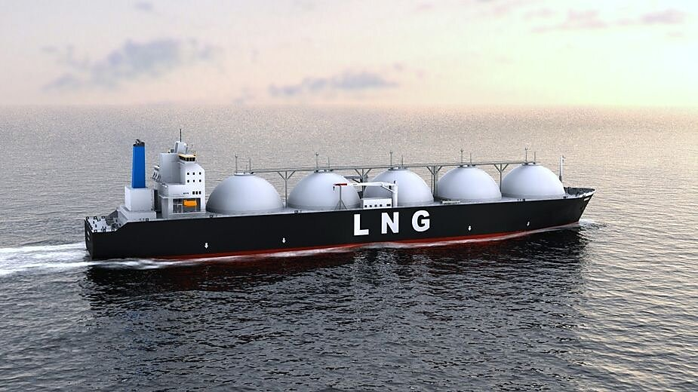
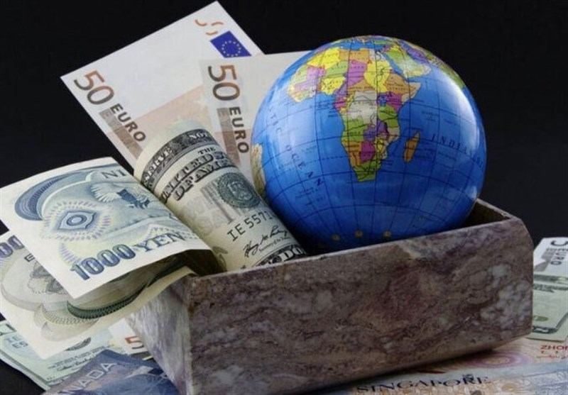

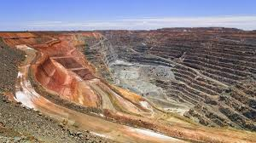

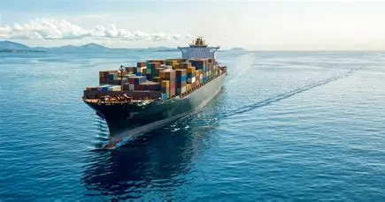
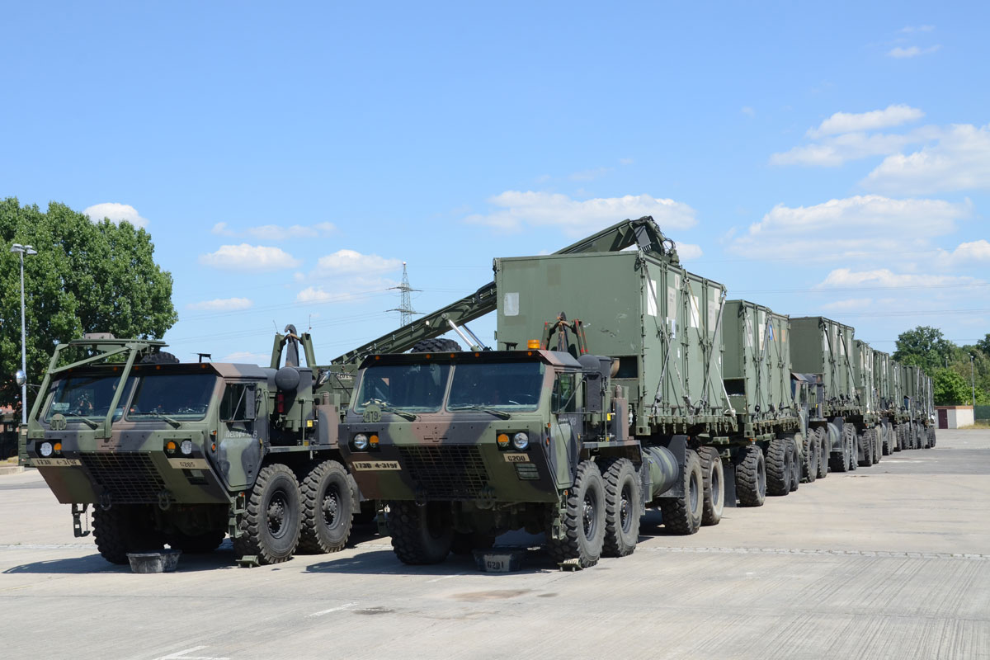


Additional Elements
Purchase commitments
Defense and security cooperation
FDI in US
Political issues
Japan: $550 billion
Korea: $350 billion
EU: $600 billion?
E.g., Net Zero Shipping Framework

Slide 7
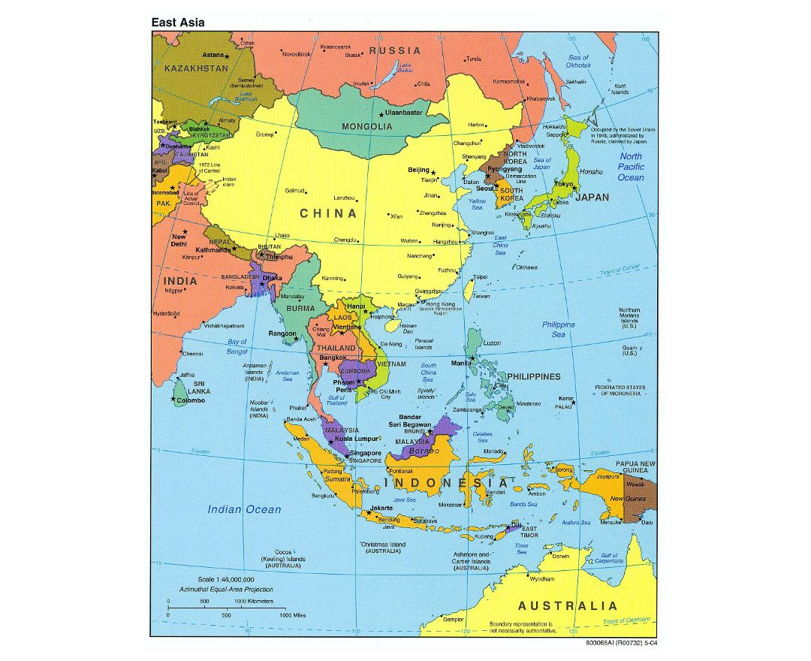
July 31 “Reciprocal” Tariff Rates
Brunei 25%
Cambodia 19%
China 10%*
Fiji 15%
India 25%**
Indonesia 19%
Japan 15%
Laos 40%
Malaysia 19%
Myanmar 40%
New Zealand 15%
Philippines 19%
South Korea 15%
Taiwan 20%
Thailand 19%
Vietnam 20%
* + 20% fentanyl tariffs; 125% tariff paused until Nov 10
** +25% penalty for importing Russian oil

Slide 8
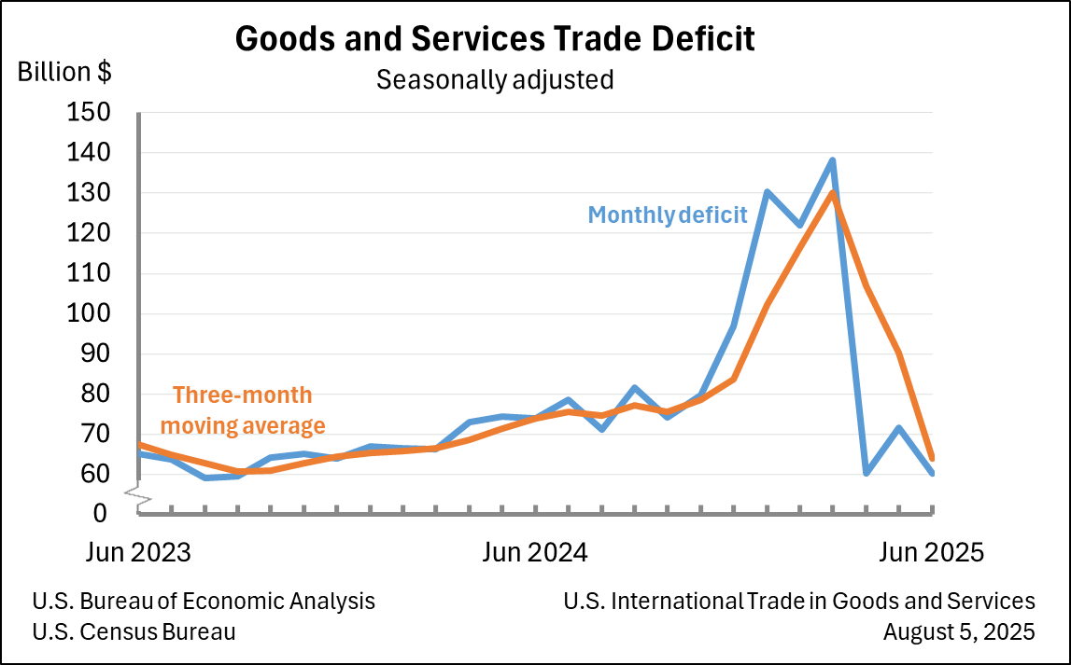
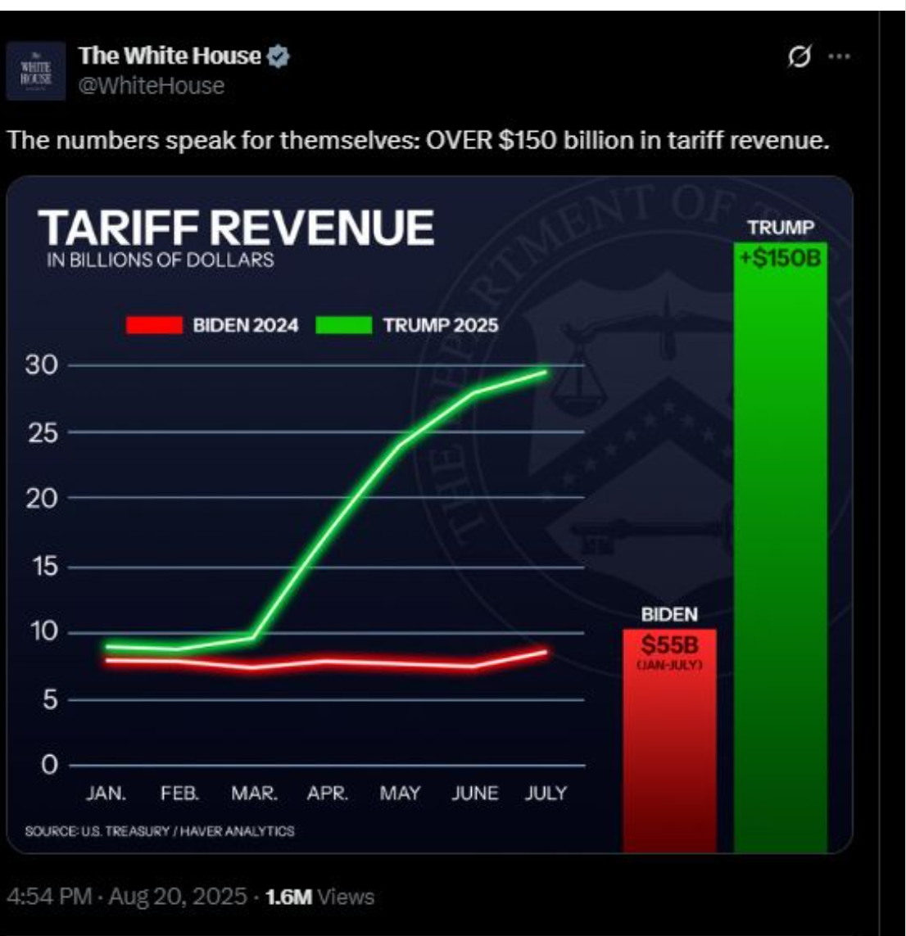
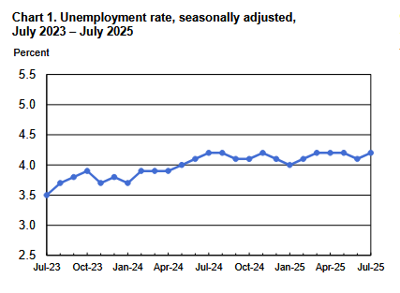
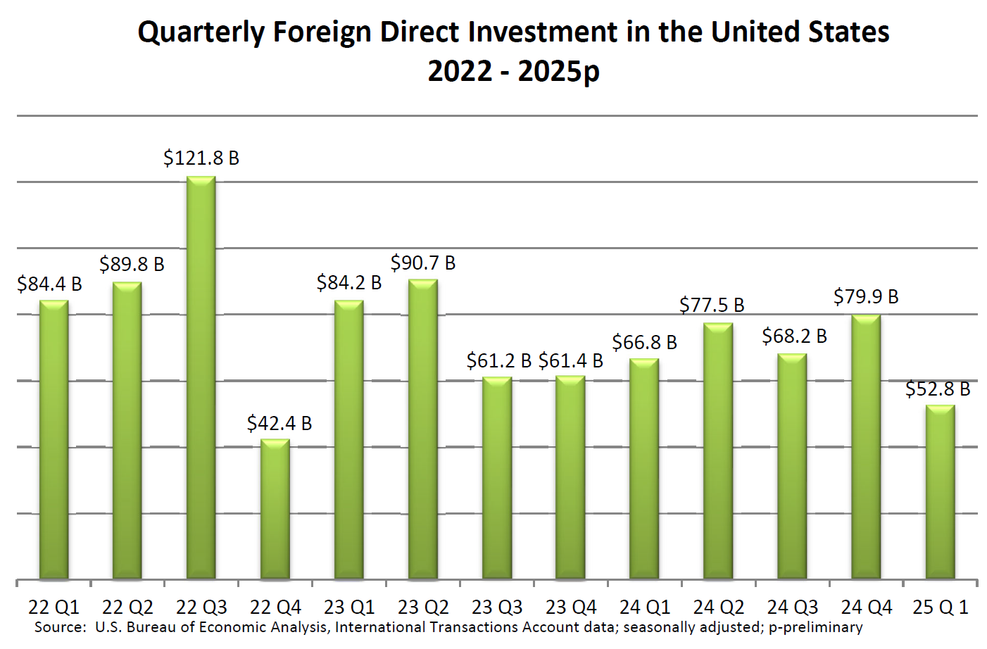
Initial Economic Impact
Up three-fold
over similar period
In 2024
Year-to-date deficit up 38.3
percent over same period in 2024
FDI down 34 percent in first
quarter, down 34 percent
Unemployment rate has remained
in a narrow range of 4.0 percent to 4.2
percent since May 2024 (source: BLS).

Slide 9
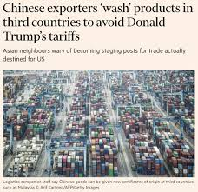
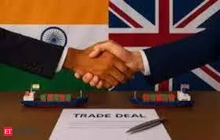
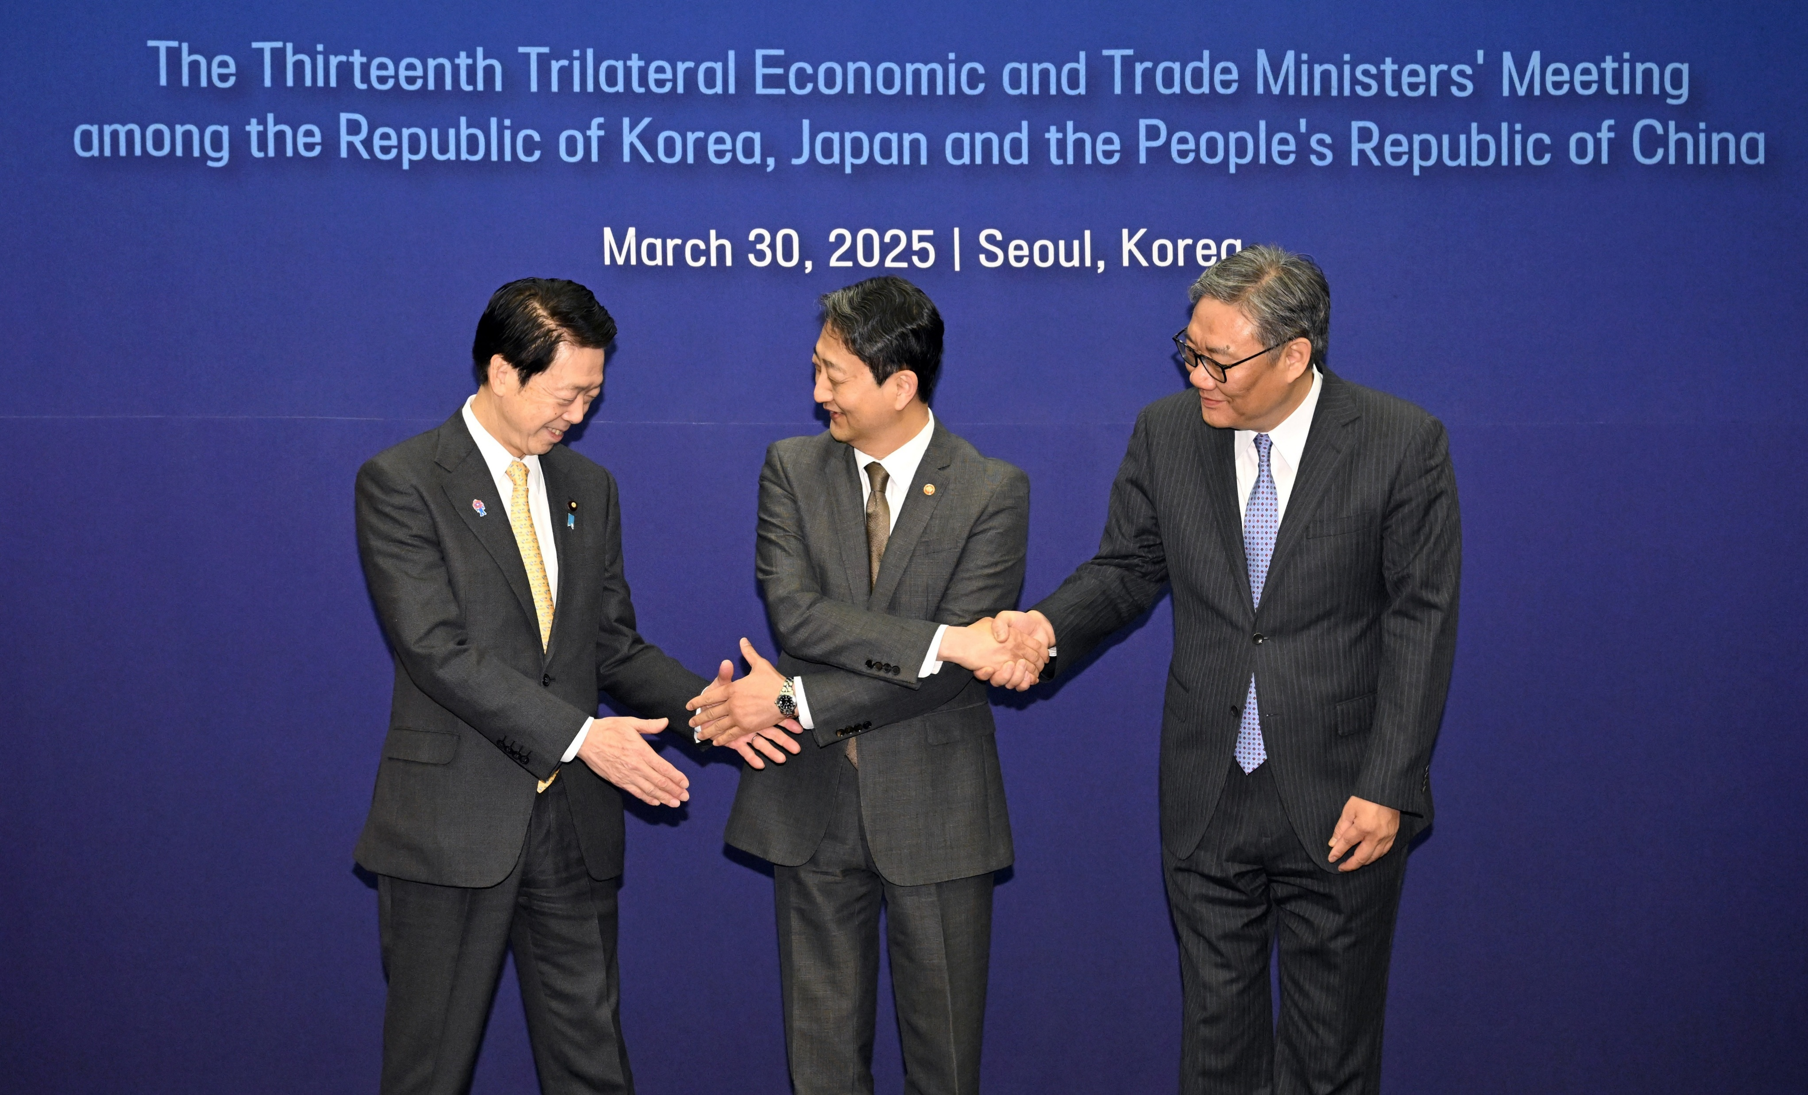
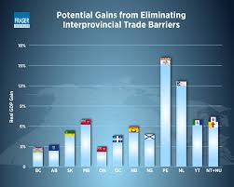

Meanwhile…
Rerouting trade thru third countries
Negotiating new FTAs and diversifying trade away from US
Strengthening engagement with with China
Pursuing for domestic reforms
China asserting soft power and global trade leadership
April 5 editorial: “No matter how the international situation may shift, China will always unswervingly expand its opening-up, steadfastly maintain the WTO-centered multilateral trading system, and unwaveringly share development opportunities with all countries.”

Slide 10
Regional and Multilateral Economic Groups and Alliances
Regional agreements and supply chains
RCEP
U.S. FTAs
China FTAs
Nicaragua
Oman
Panama
Guatemala
Honduras
Israel
Jordan
Morocco
Bahrain
Costa Rica
DR
El Salvador
South
Korea
ASEAN
Indonesia
Philippines
Thailand
Singapore
Burma
Cambodia
Laos
Switzerland
Colombia
Mexico
Chile
Peru
Brunei
Malaysia
Vietnam
Pacific
Alliance
Australia
Japan FTAs
China
India
Canada
New Zealand
Japan
Hong Kong
Papua New
Guinea
Russia
Taiwan
U.S.
CPTPP
APEC

Slide 11
New Indo-Pacific FTA negotiations
ASEAN: China upgrade, Canada, India upgrade, Digital Economy Framework agreement
India: EU, New Zealand, Chile, Oman, GCC
Indonesia: EU, Eurasian Economic Union, GCC, CPTPP accession
Japan: Turkey, Colombia, China-Japan-Korea, Bangladesh, GCC, UAE
Korea: UK, Mexico, Ecuador, Mercosur, Digital Economy Partnership Agreement
Malaysia: EFTA, EU, GCC
Philippines: EU, Israel
Thailand: Korea, EU, Peru
China: ASEAN upgrade, CPTPP accession, Honduras, GCC, China-Japan-Korea, Sri Lanka, Israel, Norway, Moldova, Panama, Korea upgrade, Peru upgrade, Switzerland upgrade, Palestine

Slide 12

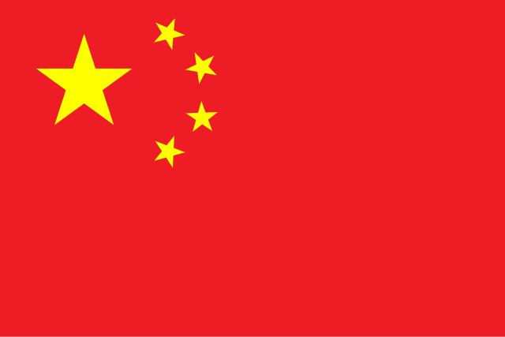
Dependence on China
China top goods trading partner:
But US top source of FDI:
ASEAN
India
Korea
Japan
Taiwan
ASEAN
Japan
Intense competition:
Soft power
Hard power

Slide 13

Continued unpredictability
New 232 tariffs
Tightened domestic content requirements
Tightened ROOs and customs requirements
Complex exceptions, responding to domestic interests
Other countries replicate US policies
New tariffs for political reasons

Slide 14
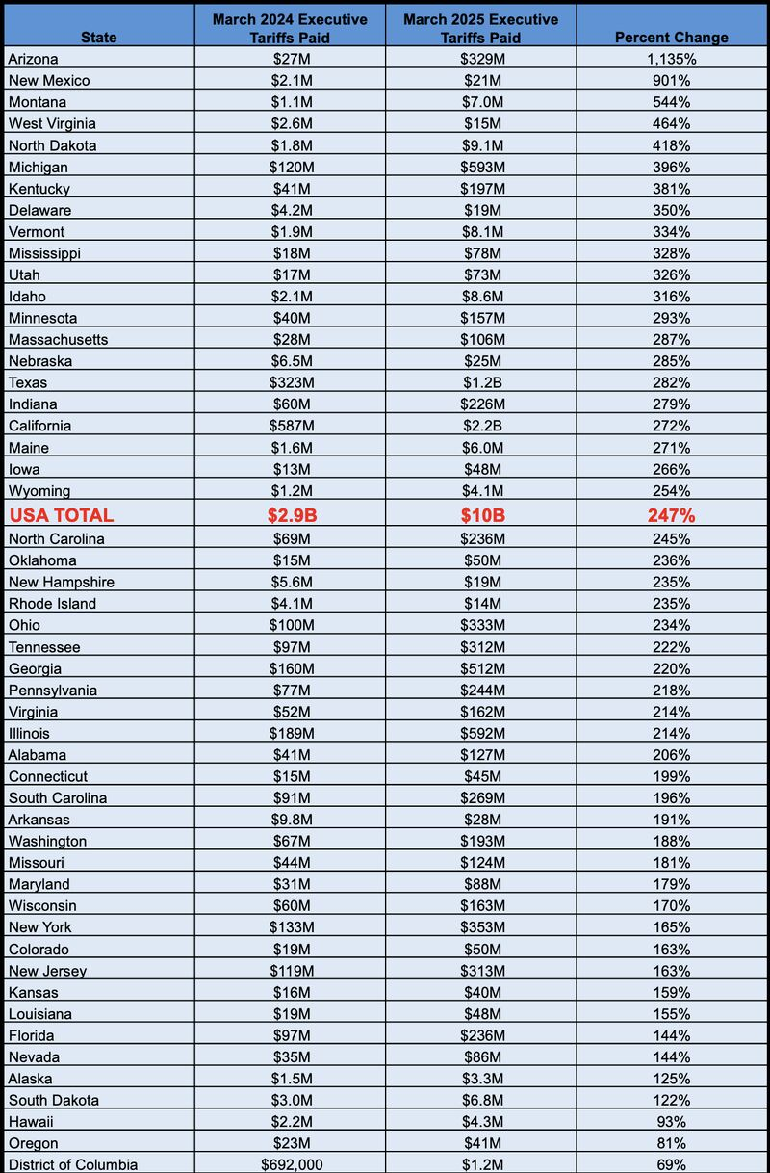
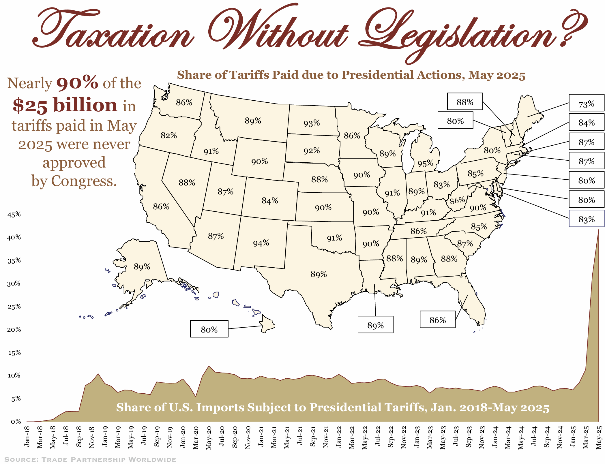
Politics: How will they affect US trade policy?
Winners and losers
Health of US economy
Source: Trade Partnership Worldwide

Slide 15
What can states do?
Legal and regulatory systems
Real and IPR protection
Financial sector
Responsible business conduct
Openness to investment
SOEs
Climate issues
Corruption
Labor policies
Transparency
Promote exports/trade missions
Communicate concerns
Lobby for exemptions
Support vulnerable businesses
Attract foreign investment
Press for federal relief

Slide 16
Thank you!
Barbara Weisel
Carnegie Endowment for International Peace
Nonresident Scholar
bfweisel@outlook.com

