Slide 1

Budget Resiliency in a Rapidly Changing Fiscal Environment
September 6th, 2025

Slide 2





The State of State Budgets
Creative Considerations
Weakening tax collections, spurred largely by the unwinding of temporary pandemic-era factors and the adoption of widespread tax cuts.
Mounting spending pressures, as temporary federal pandemic aid phases out and states face rising costs for Medicaid, employee wages, and long-term liabilities.
Structural risks ahead? It remains unclear if pandemic-era budget commitments, like tax cuts and spending increases, in response to temporary surpluses will be affordable long-term.
Federal funding and policy uncertainties are complicating state fiscal planning efforts and dampening budget forecasts.
Budget reserves remain a bright spot, with most states holding record-high rainy day fund balances. Still, reserves are not a long-term solution for structural budget gaps.

Slide 3
Kicking off Fiscal Year 2026
Creative Considerations
Preliminary analysis of FY25 revenues show collections on pace to come in above original budget projections in the final totals.
States are wrestling with revenue uncertainty. At half of states have lowered their FY26 forecasts amid growing economic and federal uncertainties.
Several states chose to increase taxes or cut spending to close budget gaps for the current fiscal year rather than draw on their reserves, with budget officials citing a desire to protect rainy day funds in case they are needed later in the year.

Slide 4

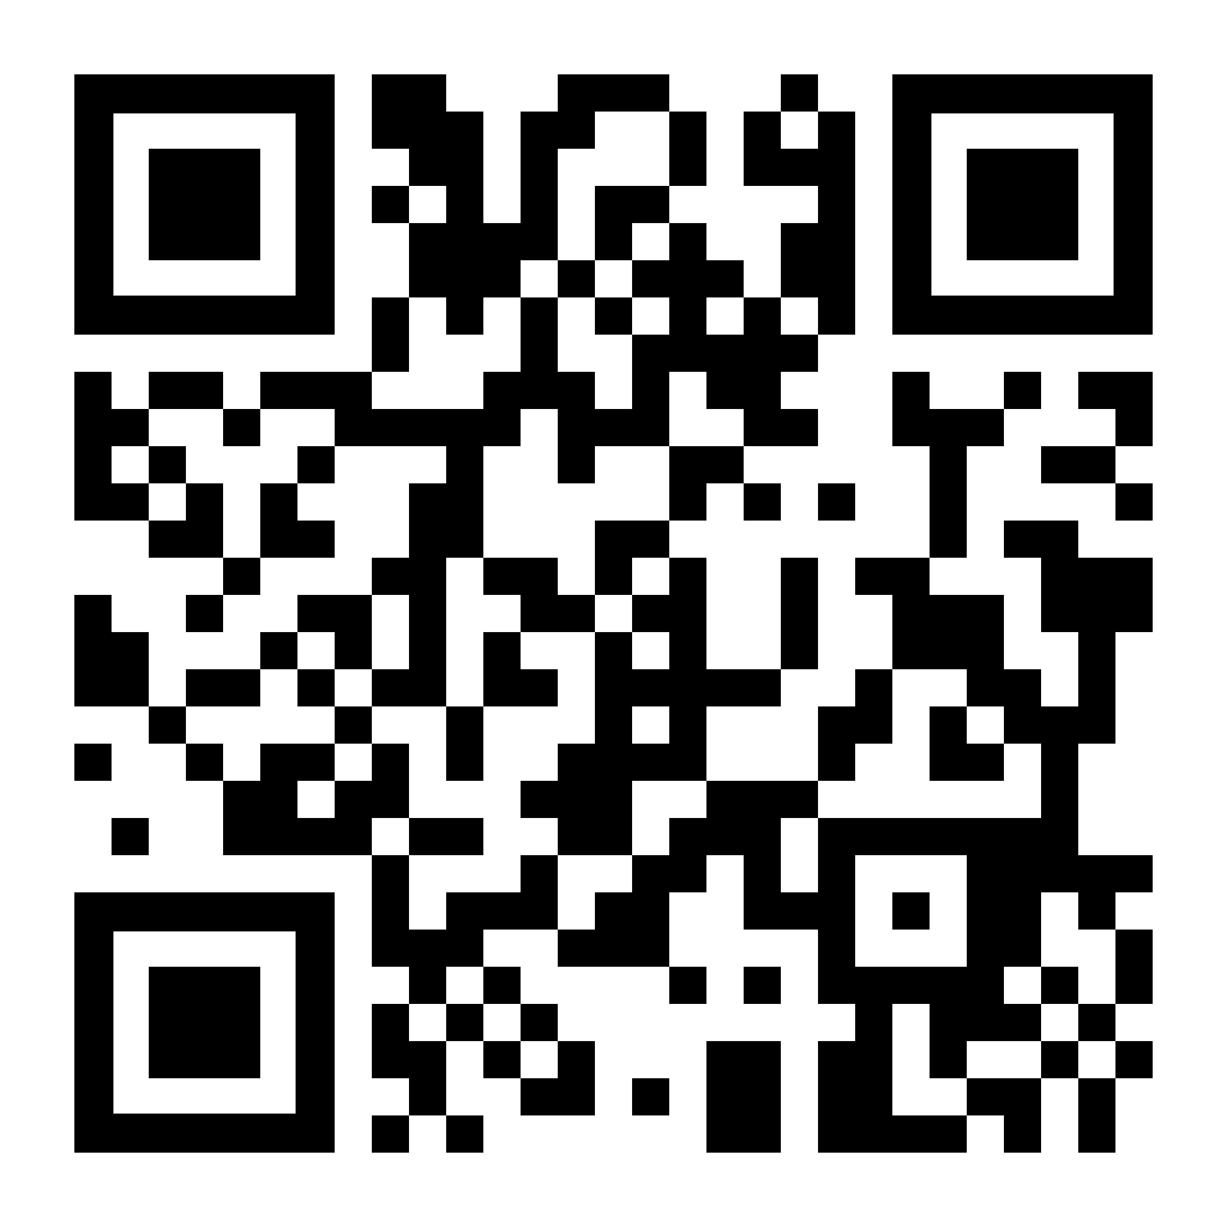
The COVID-19 Era Revenue Wave Comes to an End
The “revenue wave” is slowing
From 2020 – 2022, states collected nearly 40%, or $152 billion, more than they were on track to pre-pandemic. Now, state tax collections are weakening, spurred largely by the unwinding of temporary pandemic-era factors and the adoption of tax cuts.
Mounting spending pressures
Temporary federal pandemic aid is phasing out while states face rising costs for Medicaid, employee wages, and long-term liabilities.
Scan QR code to view full report

Slide 5
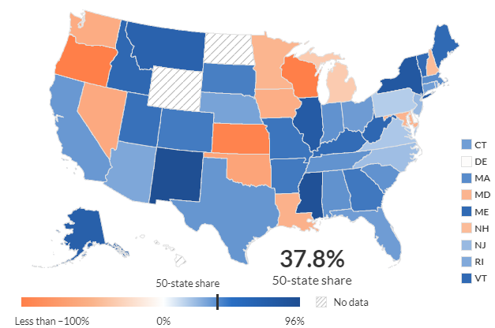
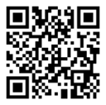
More Than a Third of New Tax Revenue Over 3 Years Exceeded Pre-Pandemic Trends
Difference from trend as a percentage of new revenue, 2020-22

Slide 6
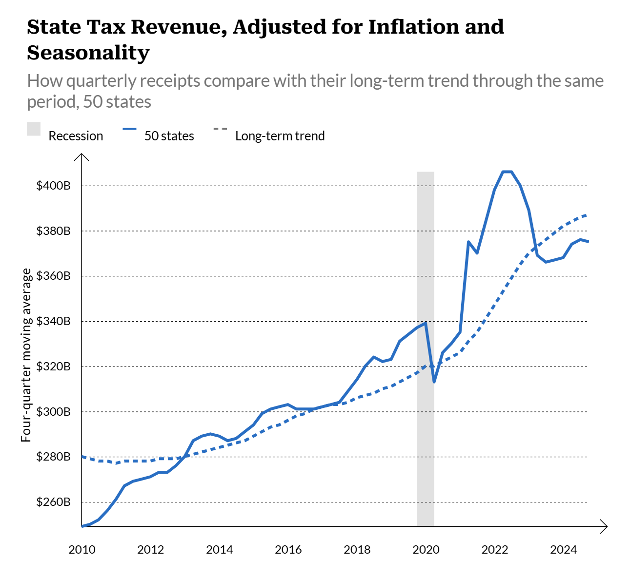
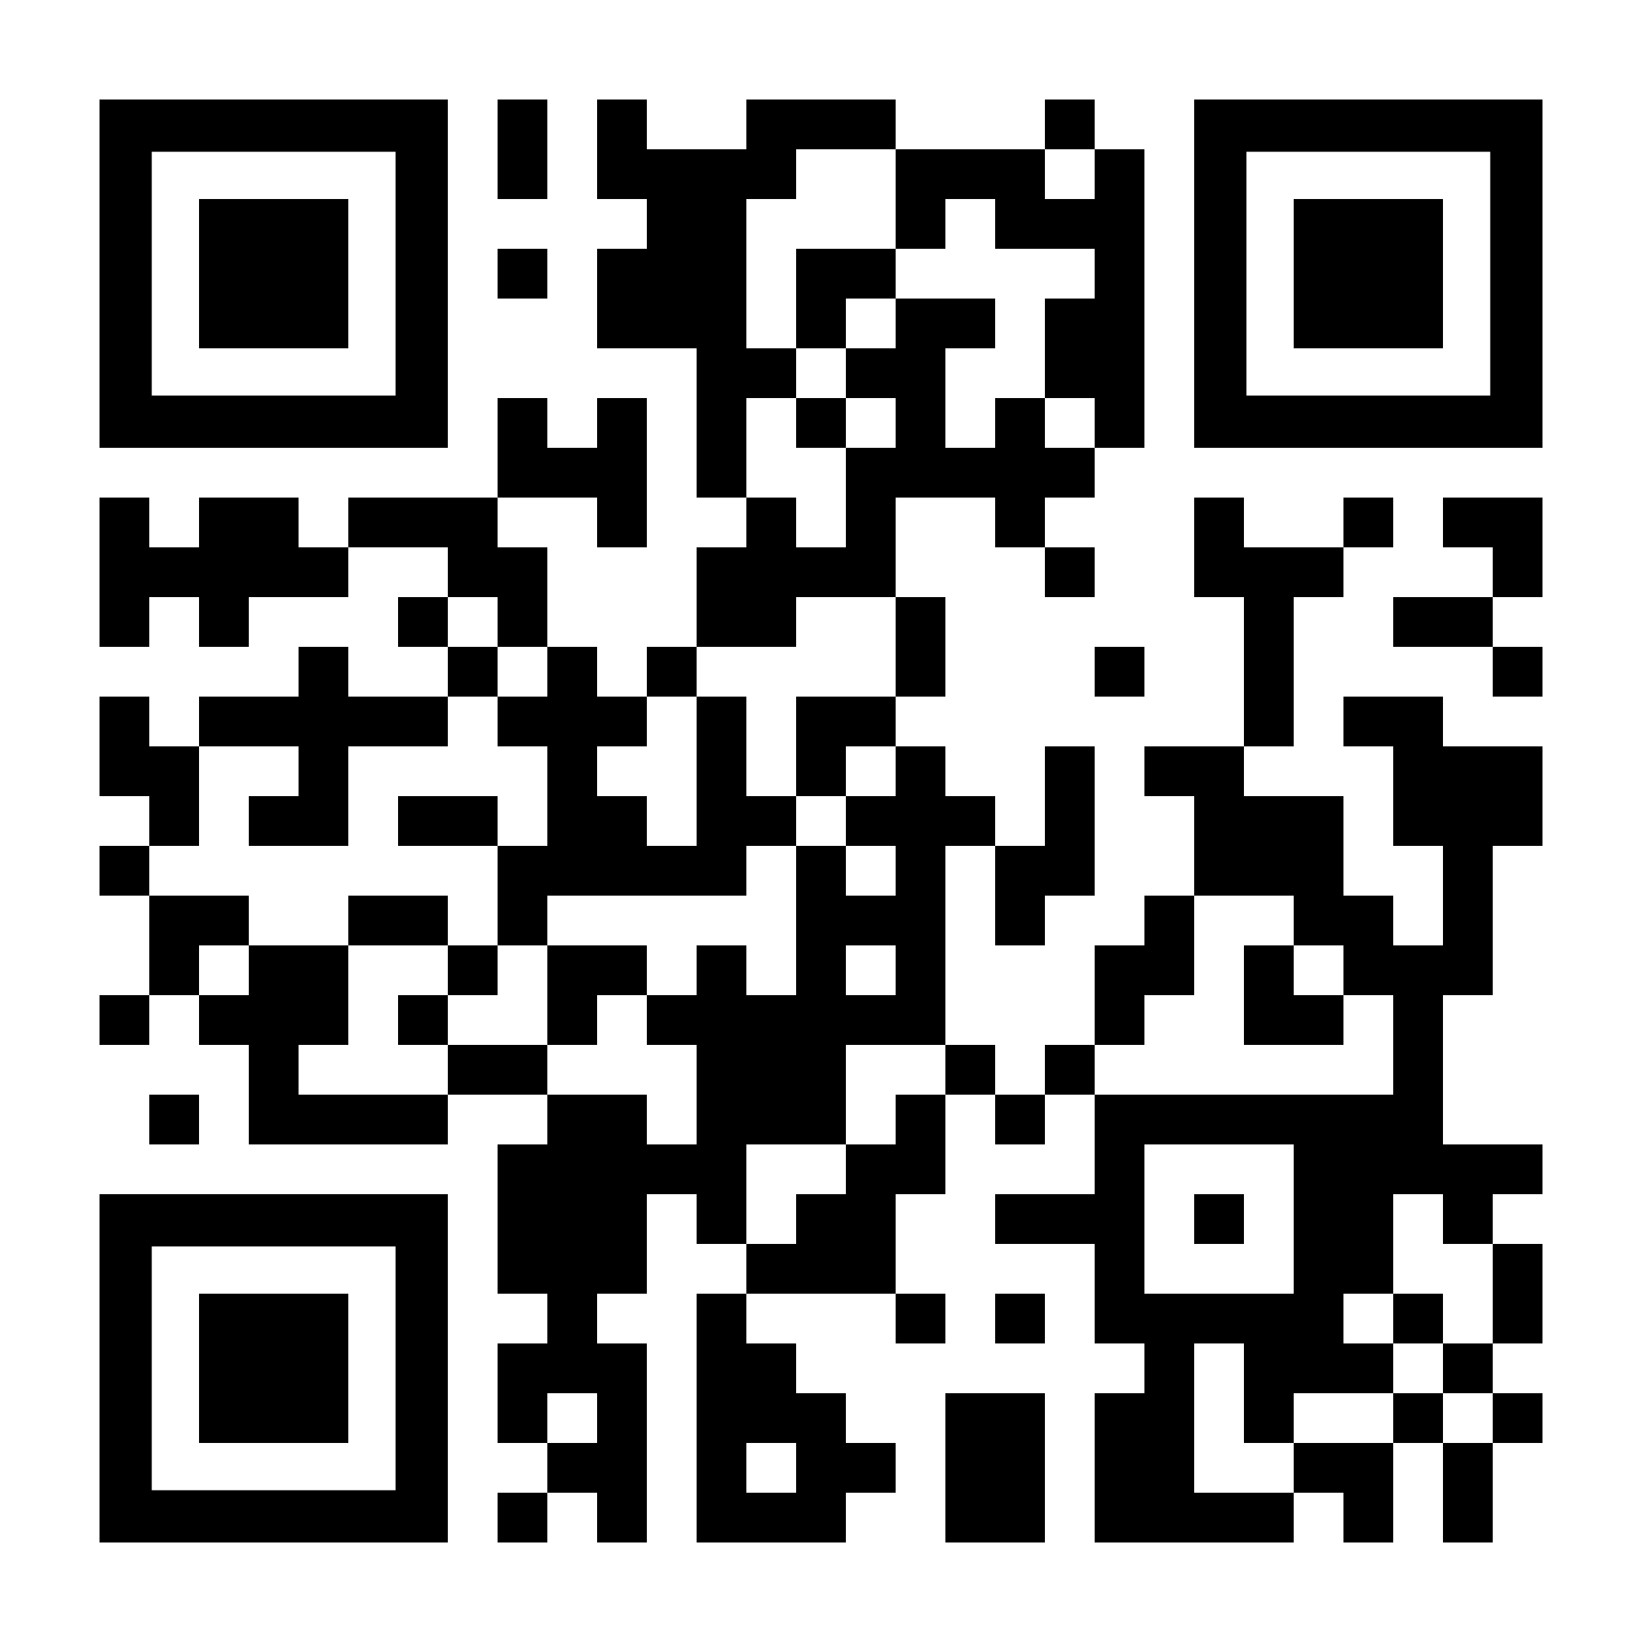
Tax revenue down from 2022 high
After peaking in mid-2022, state tax collections have weakened significantly, largely due to the phase out of temporary pandemic-era factors and widespread adoption of tax cuts.
Total state tax revenue was 3.2%, or $12.4 billion, below its 15-year trend at the end of Q4 2024, a sharp contrast from early 2022 when collections were 14.9% above trend.
Preliminary monthly data from the Urban Institute shows that total inflation-adjusted tax revenue remained sluggish in the first half of 2025.
Note: The “long-term trend” value is defined as the 15-year linear trend of tax collections leading up to each quarter, after adjusting for inflation and seasonality.
Sources: Pew analysis of data from the Urban Institute, U.S. Census Bureau, and U.S. Bureau of Economic Analysis

Slide 7
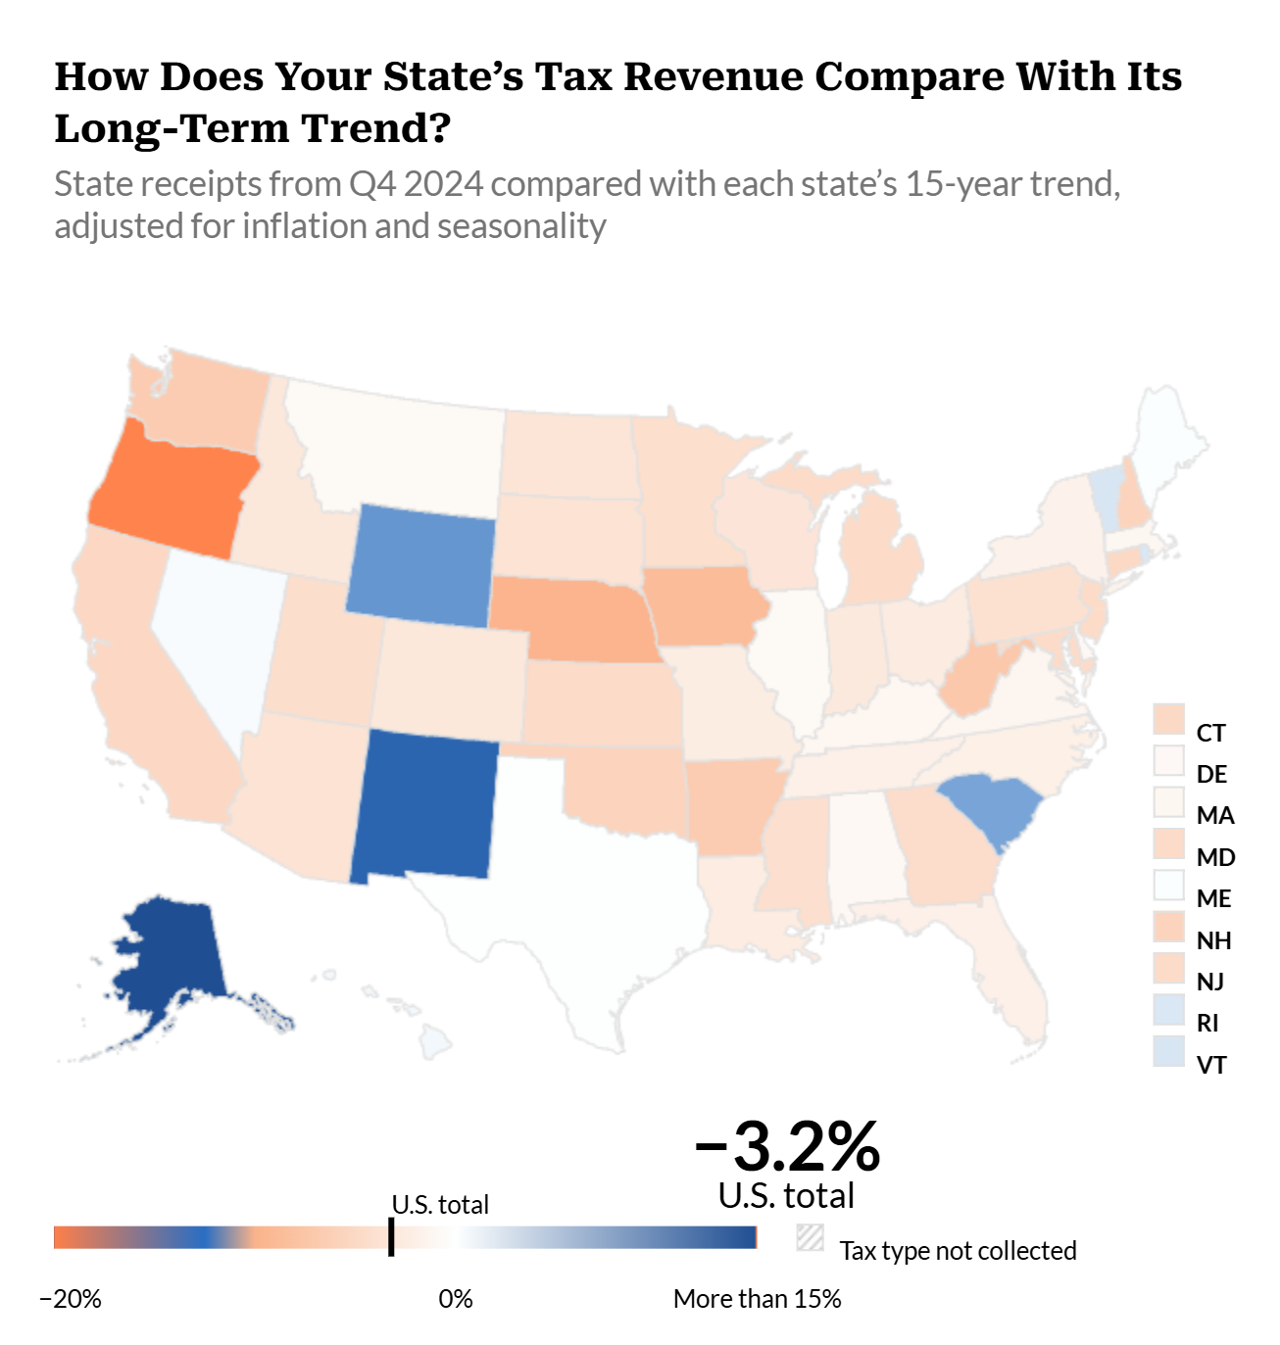
Tax revenue trends
The number of states where tax revenue is underperforming its 15-year trend has grown steadily over the past two years. At the end of Q4 2024, 40 states underperformed their long-term trajectory.
Revenue was furthest above its 15-year trend in Alaska (163.1%) and furthest below in Oregon (−19.3%).
And the median difference between collections at the end of Q4 2024 and their 15-year trend was highest in the Northeast, at −1.7%, and lowest in the Midwest, at −3.6%.

Slide 8
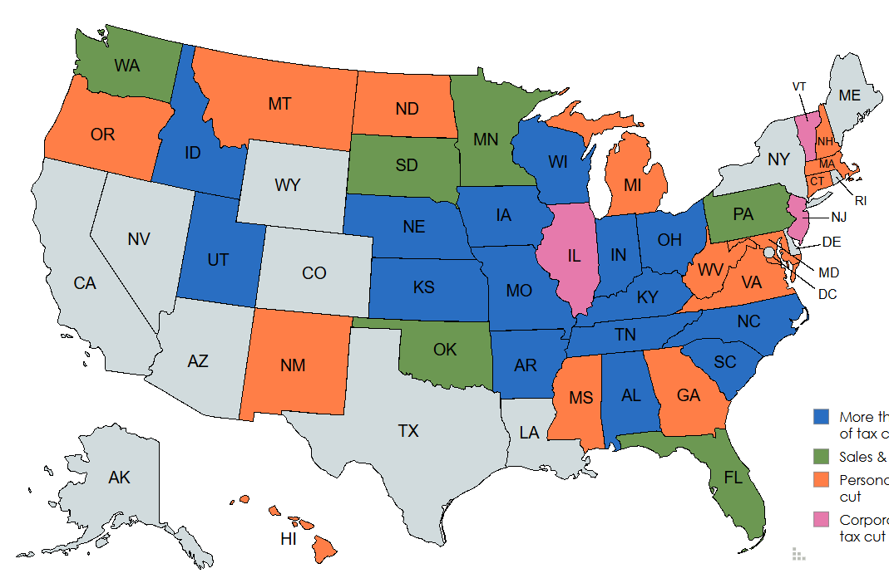

State policy actions: Sales, Personal Income, and Corporate Income Tax Reductions Implemented in FY 2024 and FY 2025
More than one type of tax cut
Sales & use tax cut
Personal income tax cut
Corporate income tax cut
Source: Pew analysis of NASBO Fiscal Survey of the States data

Slide 9
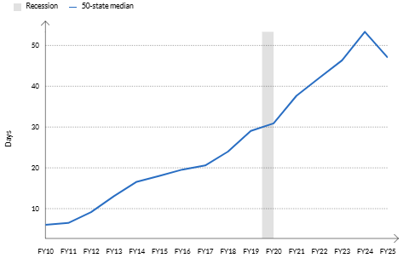
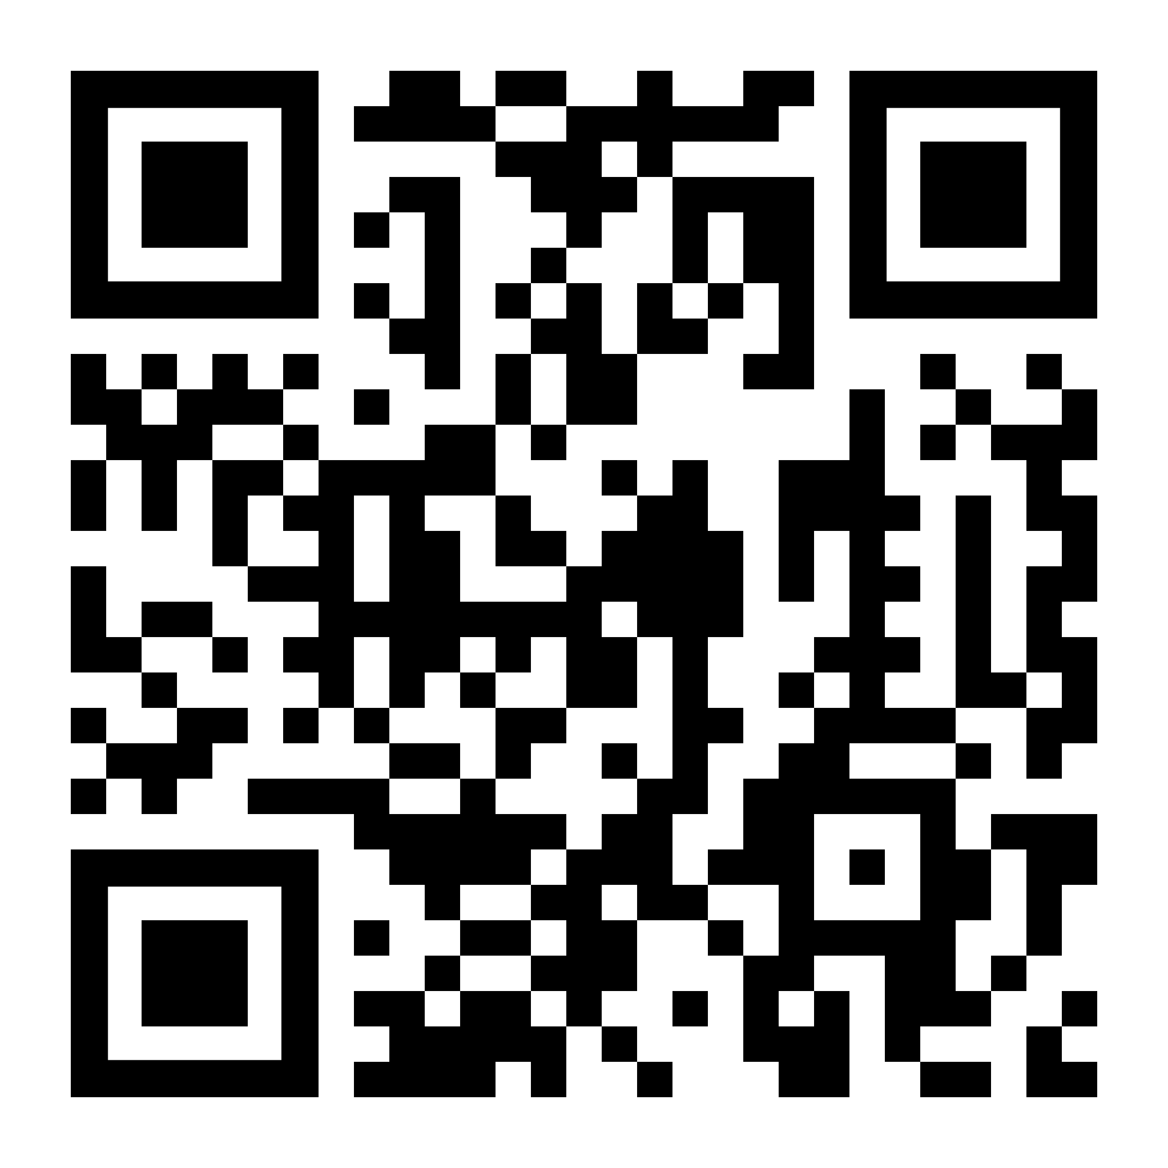
Rainy Day Fund Balances
Days Each State Could Run on Only Rainy Day Funds
​
Fiscal years 2010-2025, estimated
As of the start of FY 2026, states reported having an estimated $165 billion in rainy day fund savings, enough to run government operations for a median of 46.9 days, equal to 12.8% of spending.
FY 2025 marked the first year since the Great Recession where median rainy day fund capacity declined. Still, rainy day funds were 62% stronger than they were in FY 2019, pre-pandemic.
The strength of states’ rainy day funds ranged widely in FY 2025—from 320.2 days’ worth of spending in Wyoming to nothing in New Jersey.

Slide 10
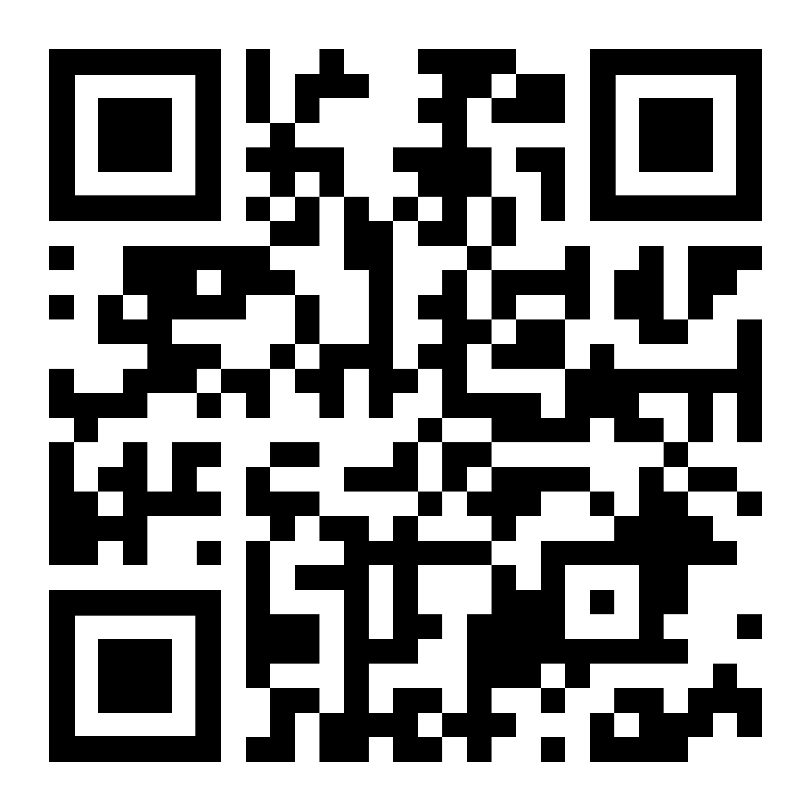
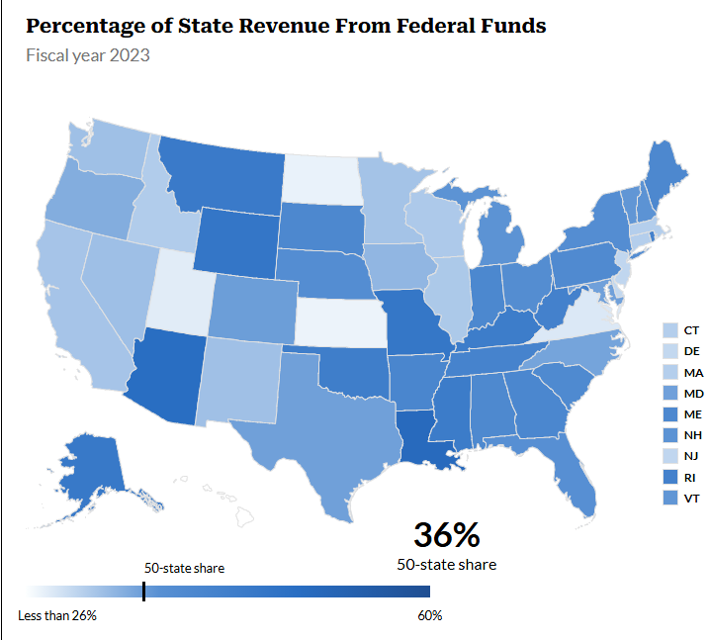
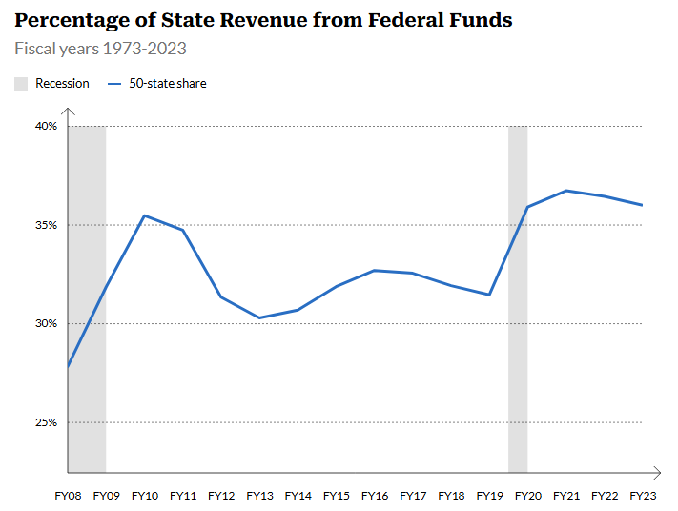
Federal Funds are a Key Part of State Budgets

Slide 11
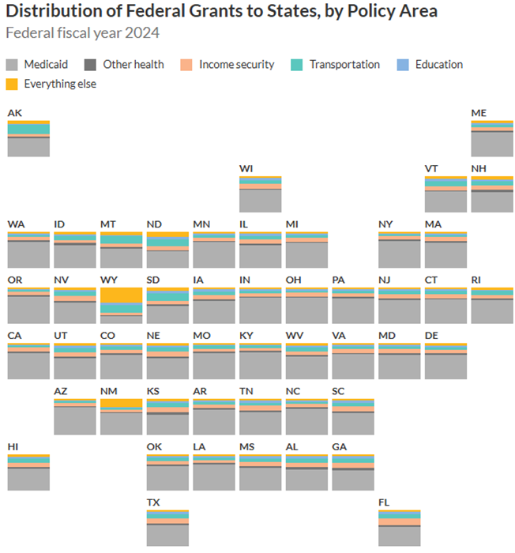
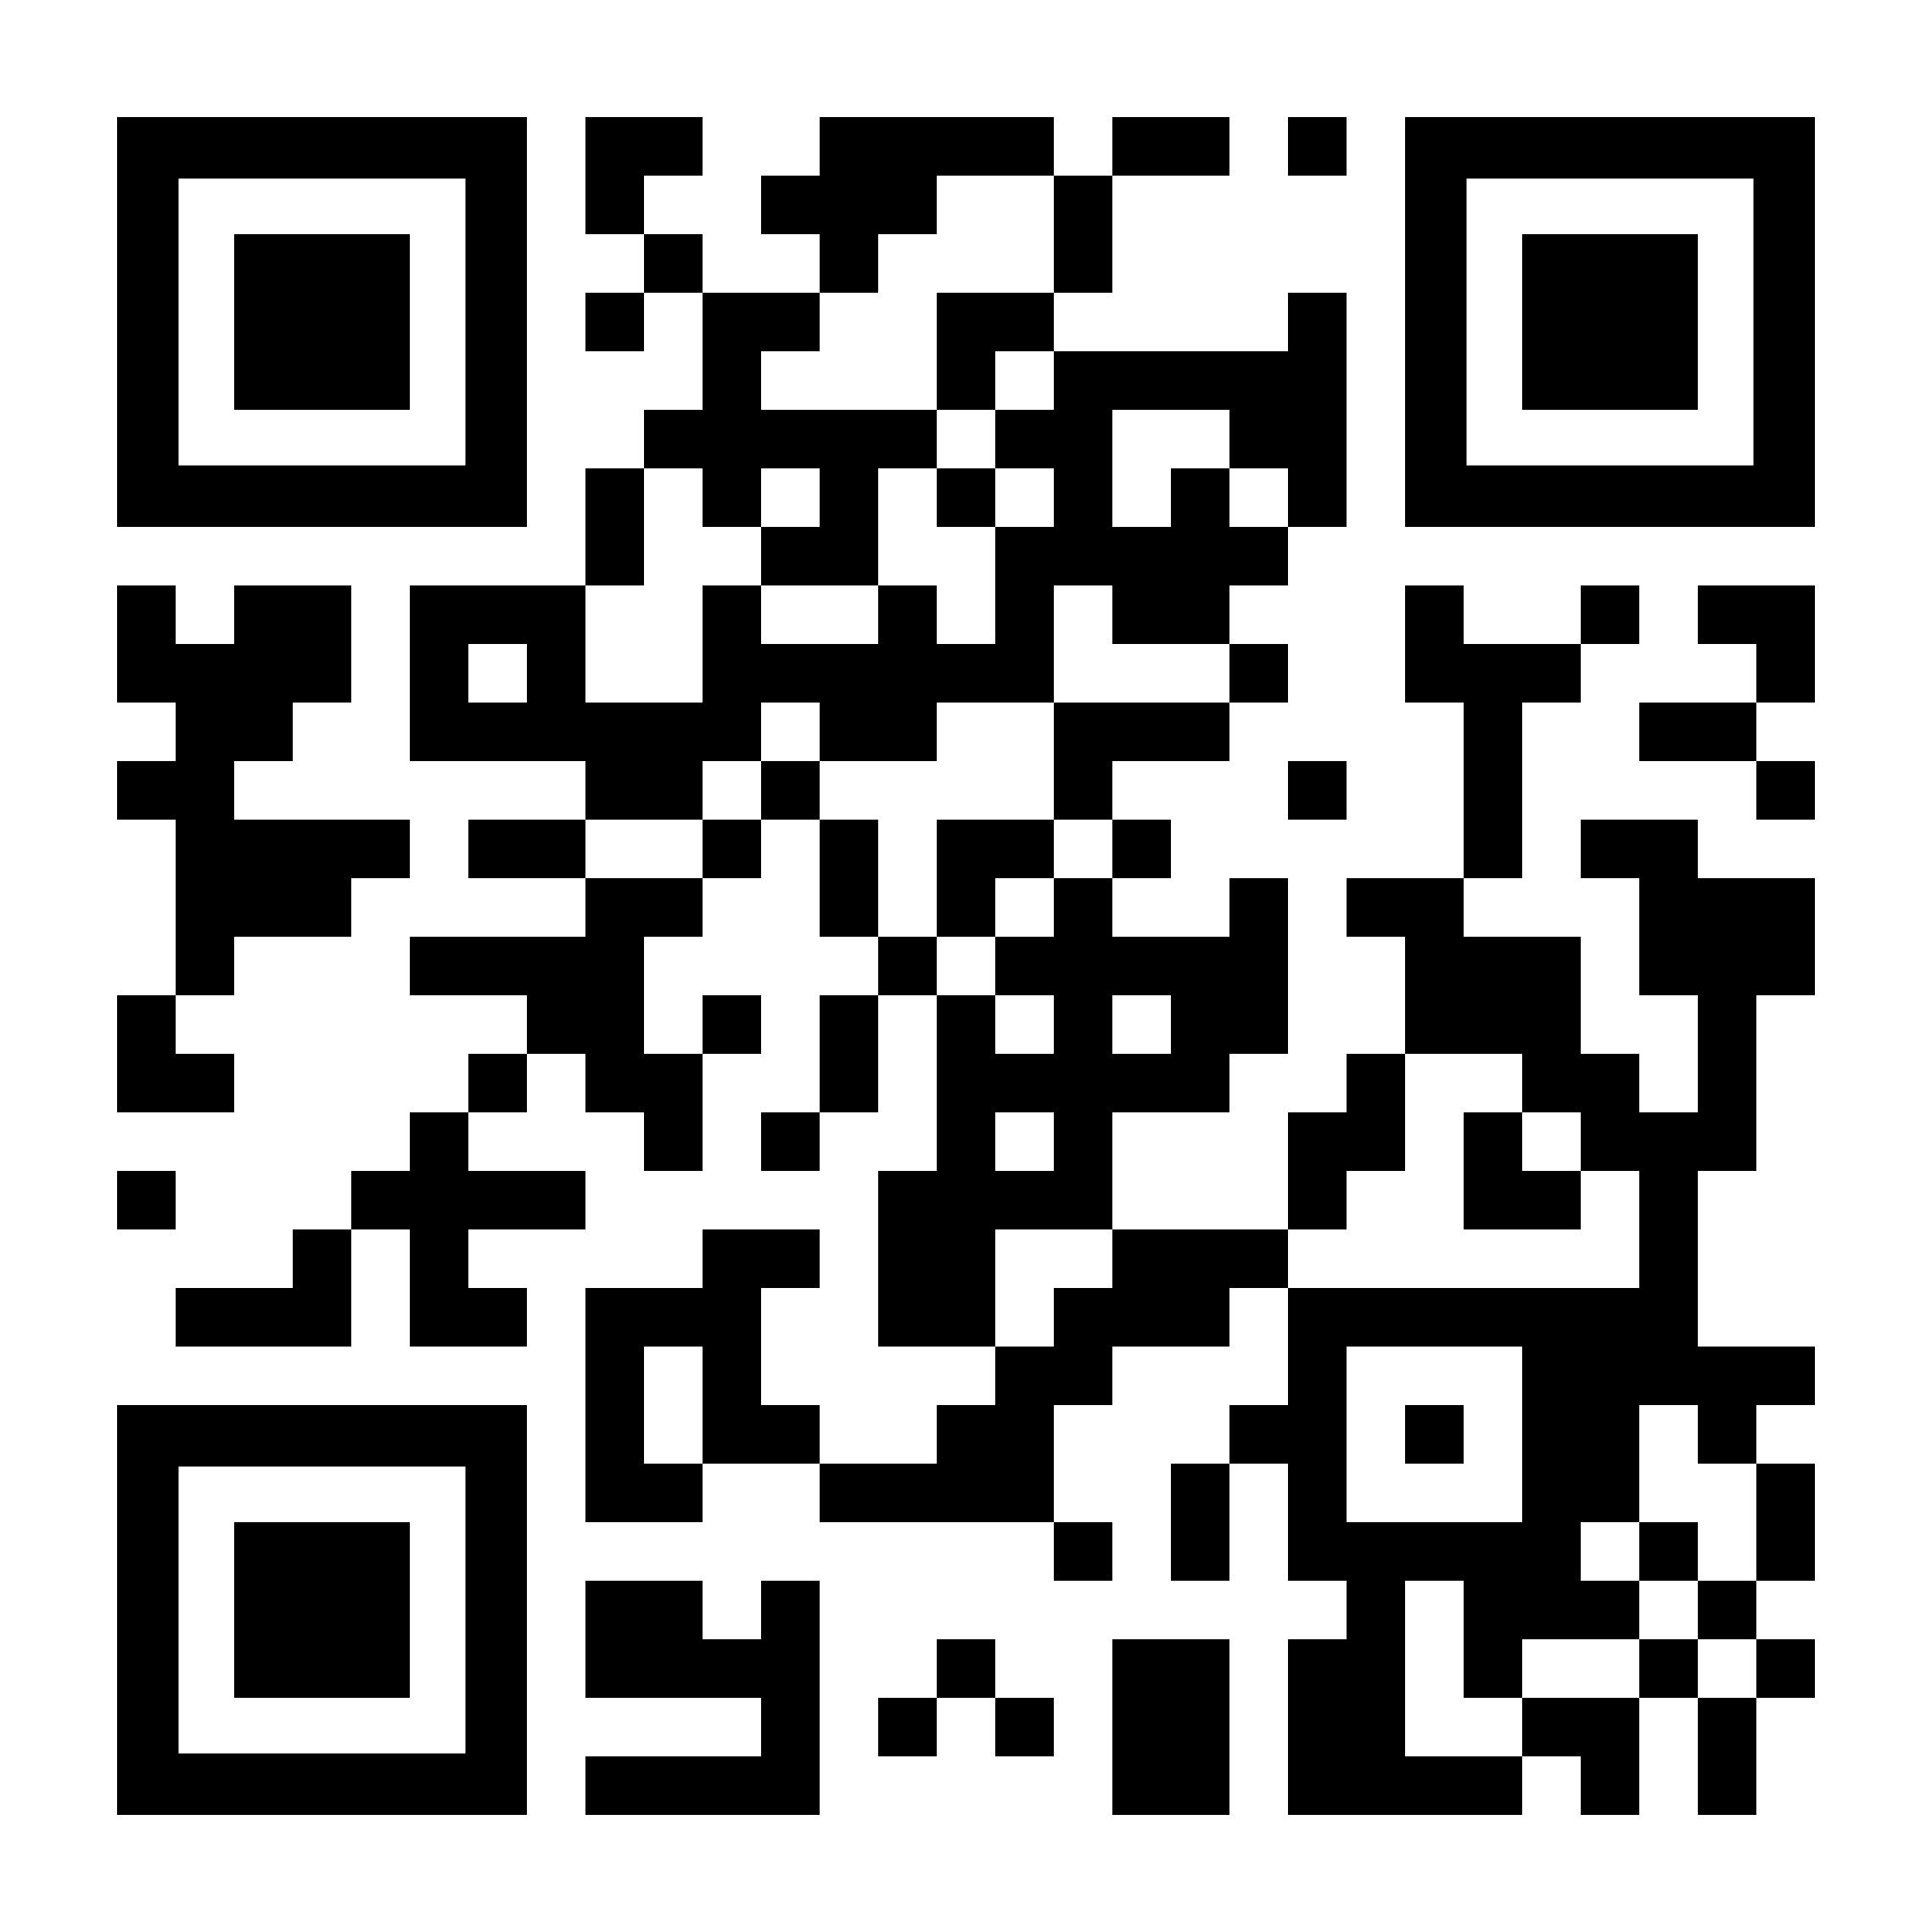
Distribution of federal funds
Medicaid funding reigns supreme: Medicaid makes up about 69% of all federal grants to states, and in 2024 was the largest source of federal funding in all but one state.
Other grants fall into the following buckets:
Income security programs (11%)
Transportation programs (8%)
Education programs (5%)
Other (non-Medicaid) health programs (4%)
Everything else, which includes things like housing programs, environmental protection, and public safety (3%)

Slide 12
Federal Funding and Programmatic Changes Impact States
Creative Considerations
Medicaid
CBO: federal Medicaid expenditures could decrease by $1 trillion over ten years
Majority of savings from: expansion group work requirements, limiting revenue raising through provider taxes, changes to enroll in/renew coverage, restricting state directed payments to facilities and providers
Impacts on state budgets will be felt most in 40 states and DC that have expanded Medicaid
  KFF: Medicaid reductions could result in between 8% – 20% reductions in federal spending in these states
SNAP
Changes are projected to generate $186 billion in federal savings over ten years, including:
  Requiring states to pay a portion of SNAP benefit costs
  Increasing the state share of administrative costs
TCJA Extensions, Other Tax Provisions
Federal changes will flow through to states, based on how states are linked to federal taxable income
Source: CBO, KFF
Source: CBO

Slide 13
Natural Disasters: Overlapping pressures on the system
Disaster costs are rising
Public budgets are contracting
Federal policy landscape is uncertain

Slide 14
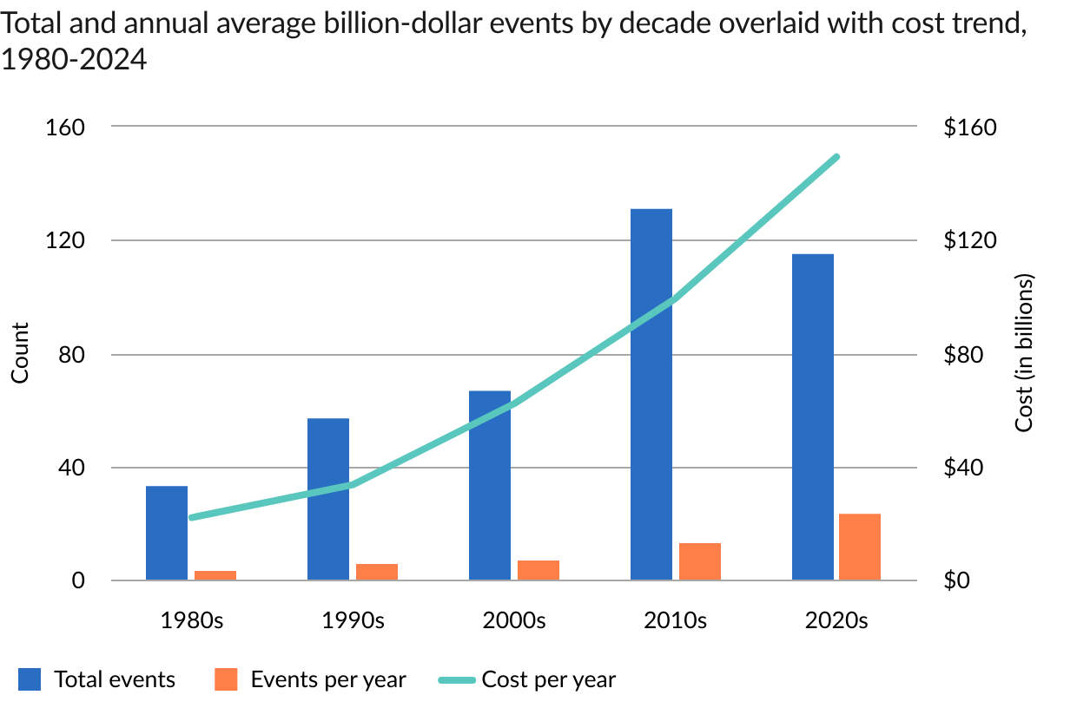
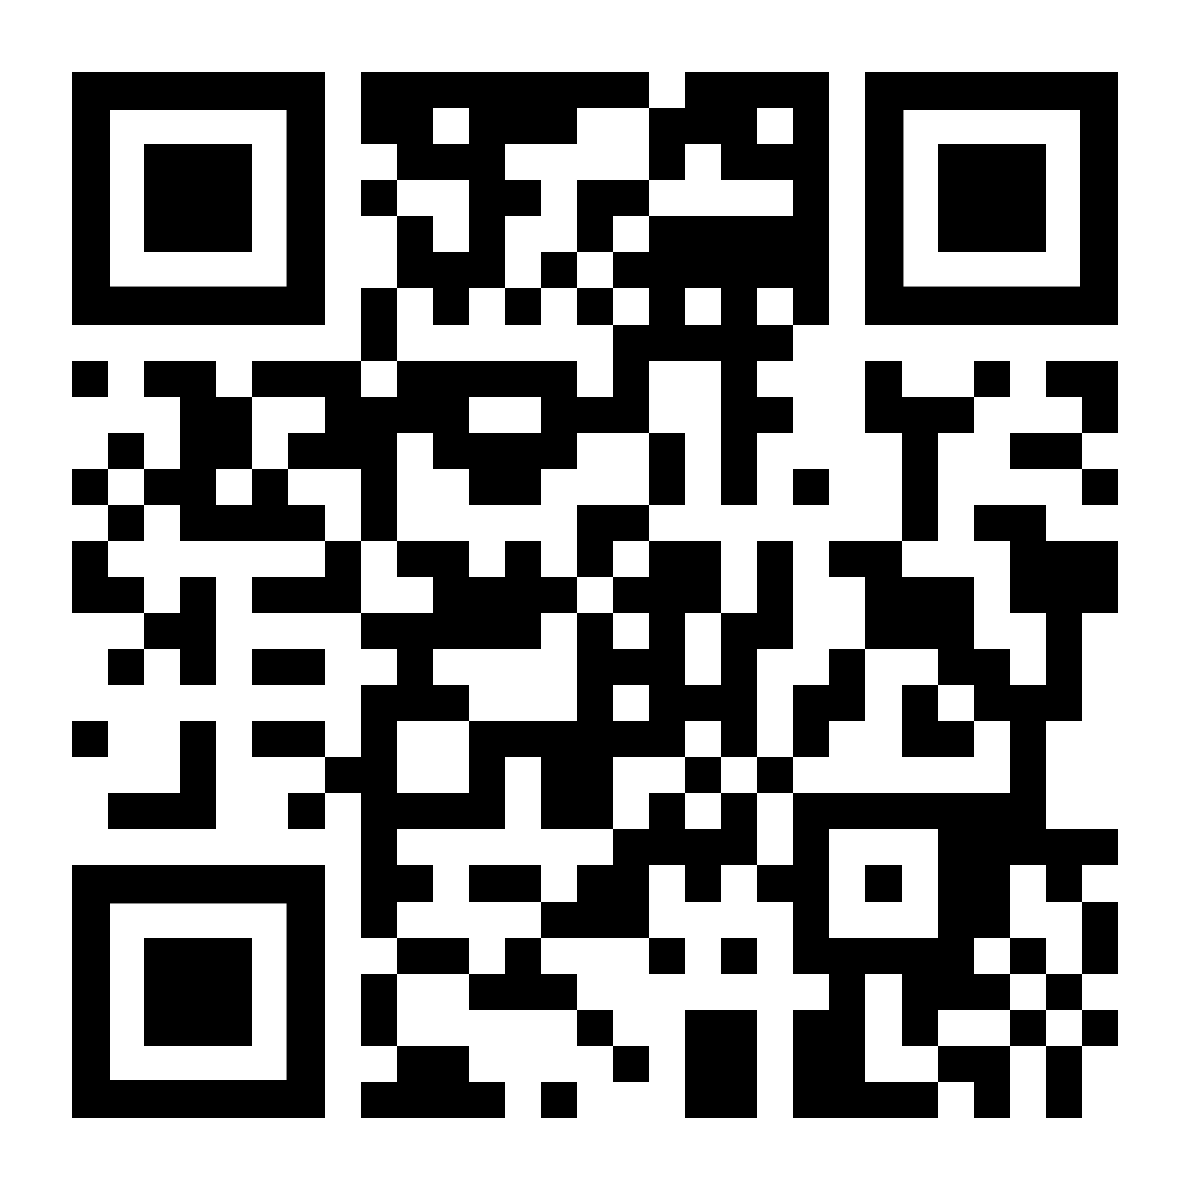
Federal Disaster Assistance Under Discussion as Events Are More Frequent, Severe, Expensive
FEMA Review Council tasked with an agency overhaul
Funding cuts for mitigation initiatives
Significant changes to criteria for disaster declarations under discussion
Source: National Centers for Environmental Information, Billion-Dollar Weather and Climate Disasters
© 2025 The Pew Charitable Trusts

Slide 15
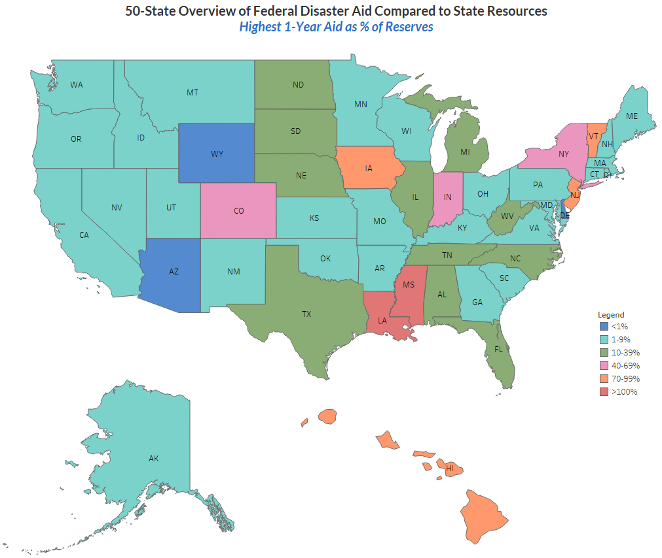
38 states had all-time high reserve balances at the beginning of 2025
In 9 states, the highest year of federal disaster aid was at least 40% of 2024 reserves.
Source: Pew analysis of data from Carnegie Endowment for International Peace and the Pew Charitable Trusts.

Slide 16
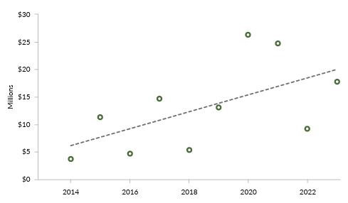
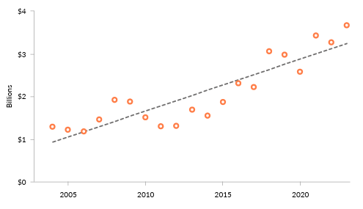
State spending on disasters has grown dramatically
Inflation-adjusted expenditures from Minnesota’s disaster contingency account, 2014-23
California’s inflation-adjusted fire protection expenditures, FY 2004-23

Slide 17
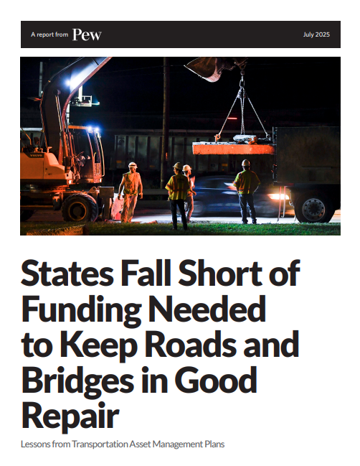
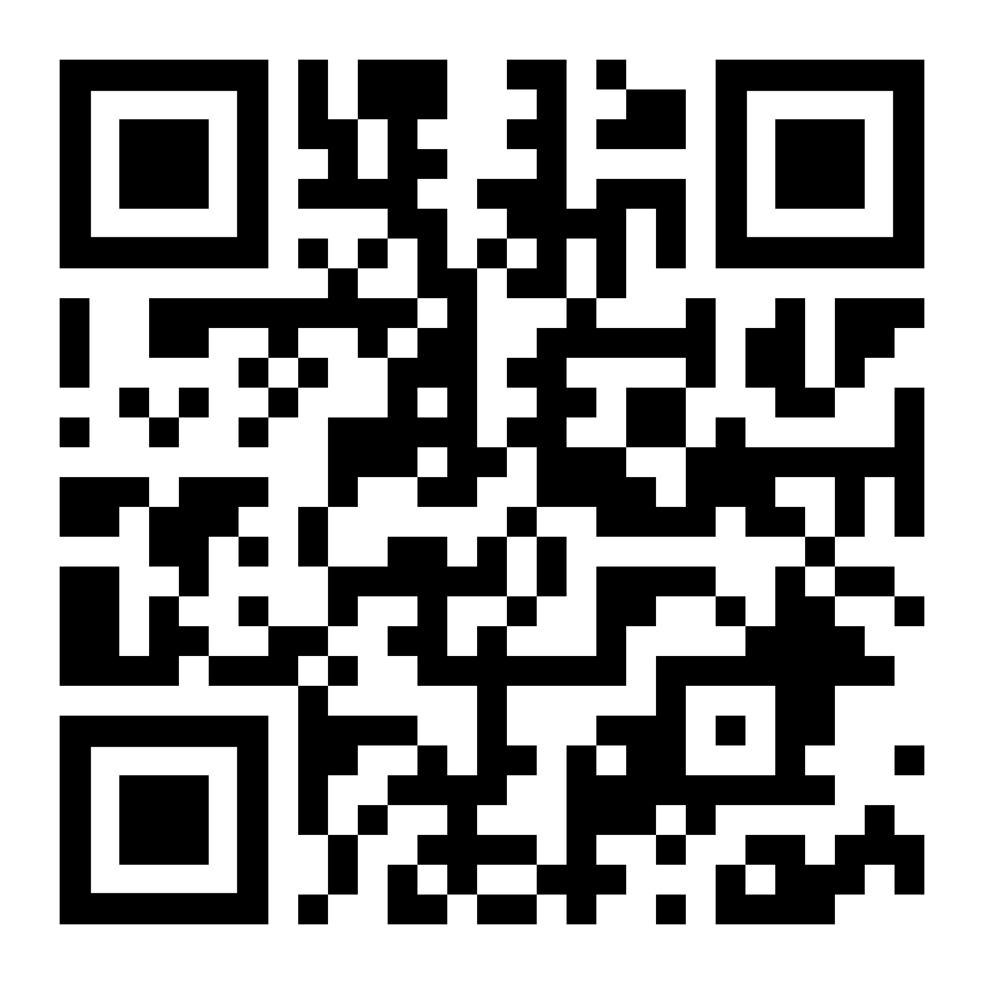
Infrastructure Investment Needs
Based on their own goals and projections, most states do not expect to be able to keep key roads and bridges in a state of good repair.
33 states expect to miss at least some of their benchmarks for roadway conditions, preservation and maintenance funding, or both over the next decade. Just 11 states are on track.
24 states reported a combined $86.3 billion funding gap over 10 years.
TAMP reporting offers an opportunity for states to better understand and budget for roadway preservation and maintenance.
Connecting TAMPs to state budgeting can guide decisions on how to adequately fund road and bridge preservation.

Slide 18
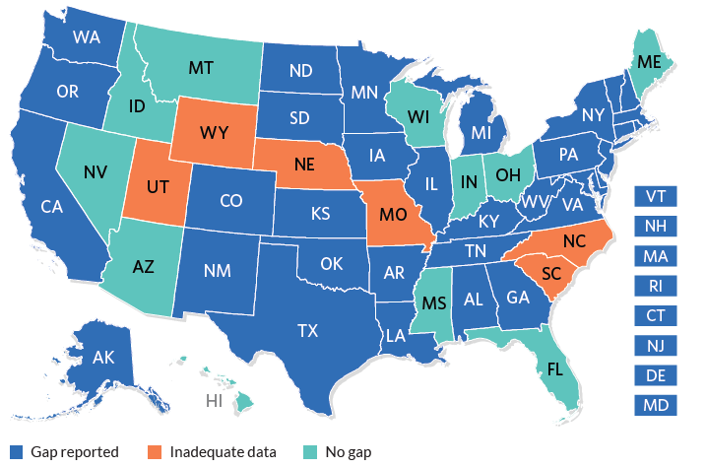
Most States Expect a Shortfall
States reporting a 10-year condition gap, funding gap, or both for TAMP roads and bridges.
Note: The base year for 10-year projections varies by state.
Source: Pew analysis of state’s most recent Transportation Asset Management Plans.

Slide 19

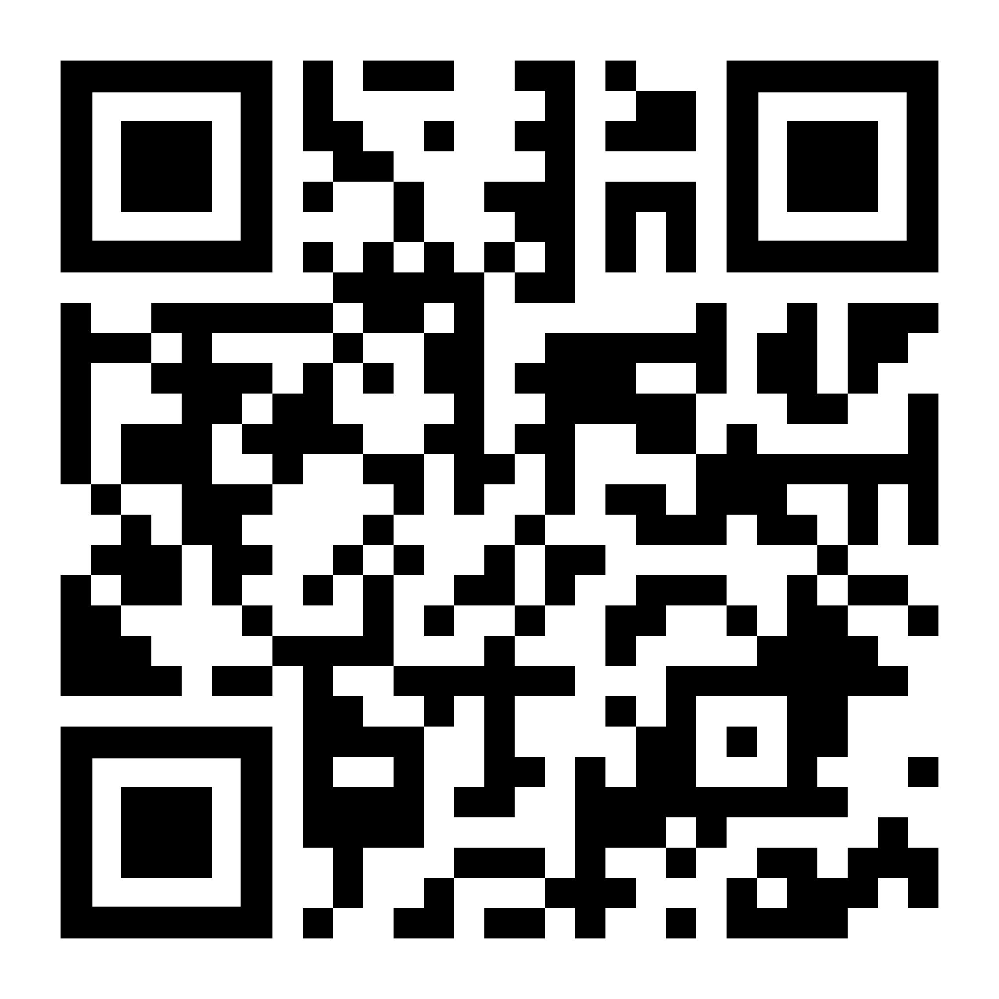
Building Blocks: Long-Term Fiscal Stability and Resilience
Structural Balance
Do resources and spending needs align over time?
Downturns and short-term shocks
Have known risks—including recessions, state-specific risks—been appropriately evaluated?
Emerging risks and trends
How can states project the impact of trends and dynamics like demographic shifts, increasing natural disaster risk, technological advancements, changing work and labor force dynamics on state budgets?

Slide 20
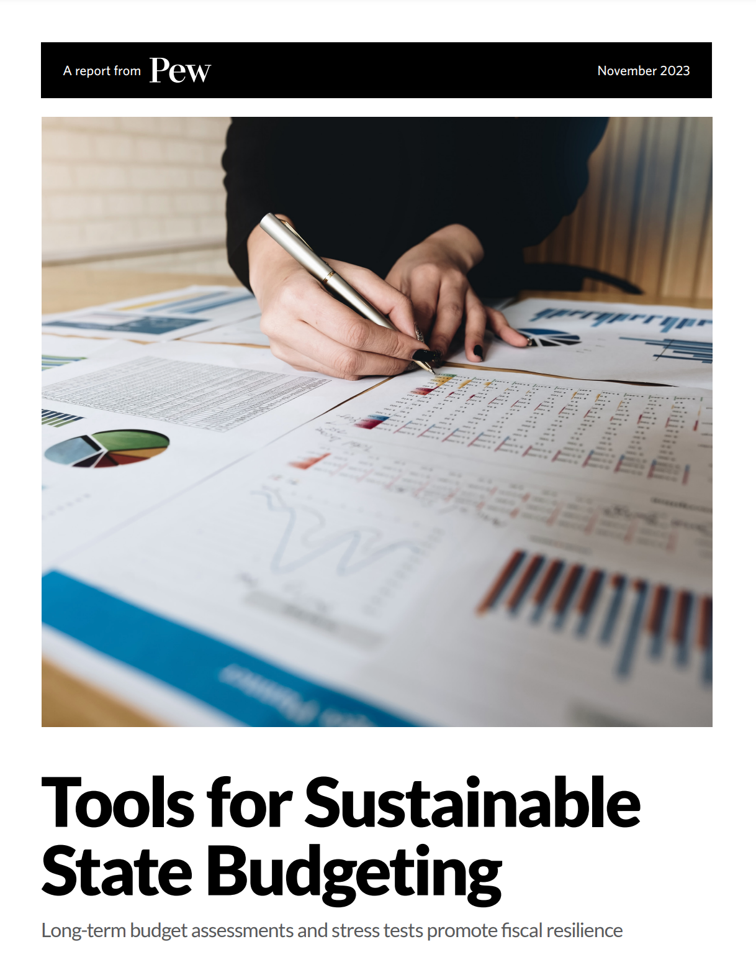
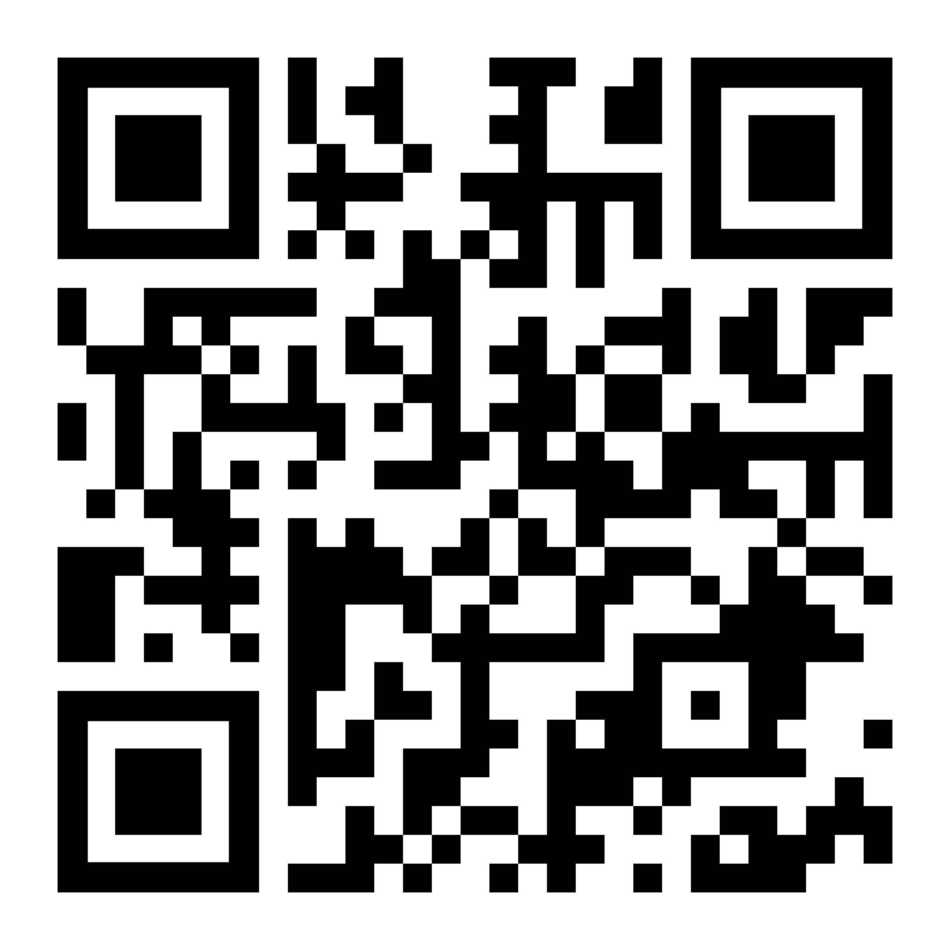
Looking Ahead, Assessing Risk
Long-term budget assessments are analyses that determine whether states are likely to face chronic budget deficits. Using multiyear projections, these studies explore whether revenue will be sufficient to support spending in future years and why or why not.
Budget stress tests analyze the fiscal risk posed by recessions and other shorter-term events. They estimate the size of temporary budget shortfalls that would result from such events and gauge how prepared states are to weather those downturns.

Slide 21
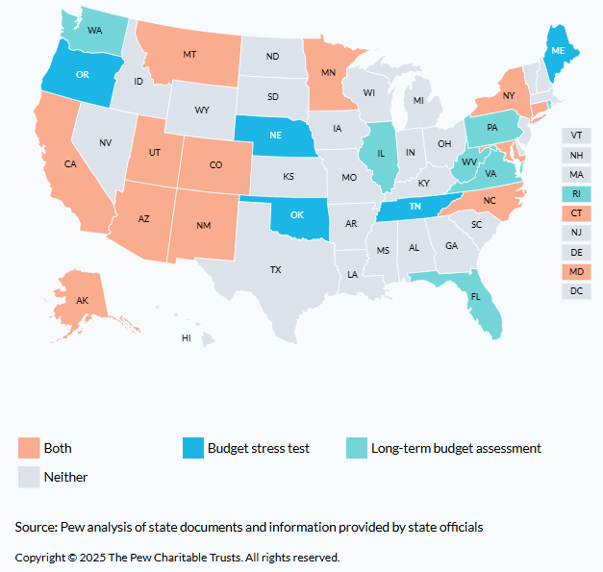
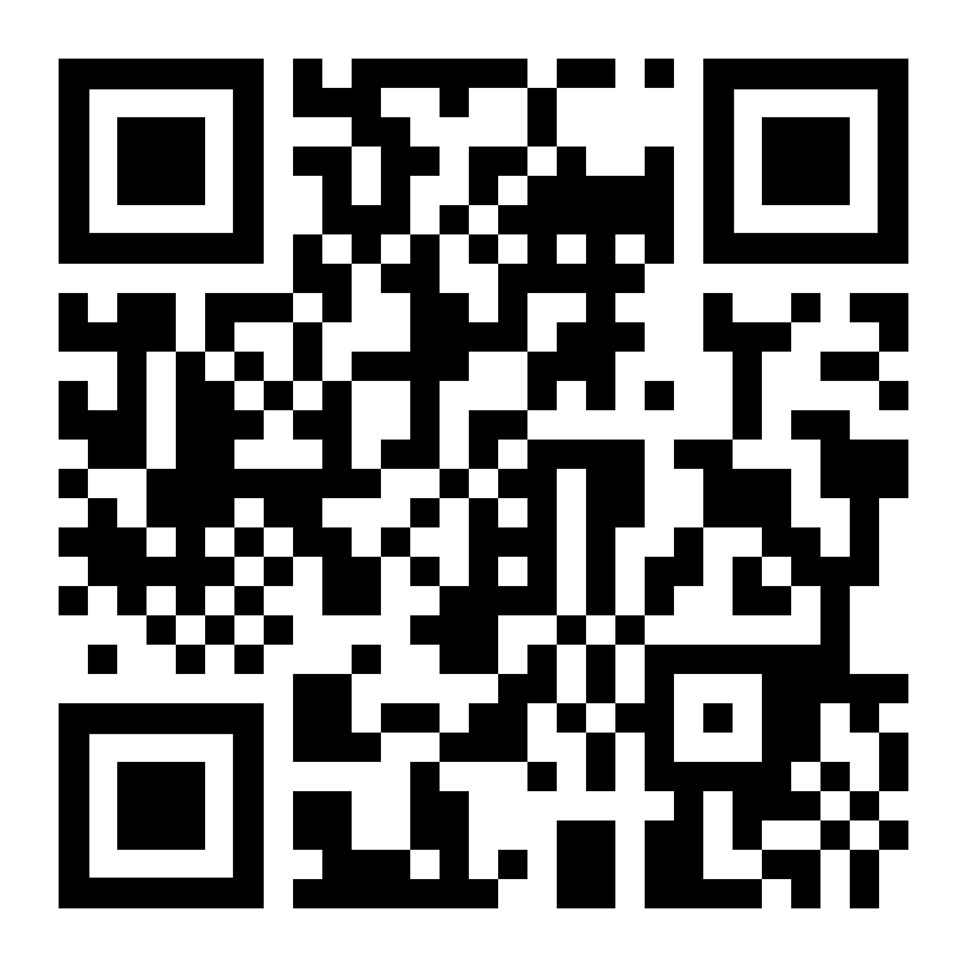
States publishing analytic tools since 2018
19 states: LTBAs
17 states: BSTs
12 states: Both
Since November 2023:
States have published more than 50 LTBAs and BSTs.
At least four states have published their first LTBA (MN, NC, VA, and WA) and at least three have published their first stress tests (AZ, OK, OR).

Slide 22
Key findings from recent LTBAs
Creative Considerations
Most states that produce LTBAs project long-term budget deficits.
States report that policymakers’ decisions to cut taxes and increase spending in the pandemic and post-pandemic period created or added to the deficits.
A range of pressures are also contributing to the challenges, including higher Medicaid costs (before OBBBA), more frequent natural disasters, aging populations, underfunded transportation infrastructure, struggling local governments, and expensive long-term liabilities.
Well-funded reserves are a significant strength but are not a long-term solution to the deficits.

Slide 23
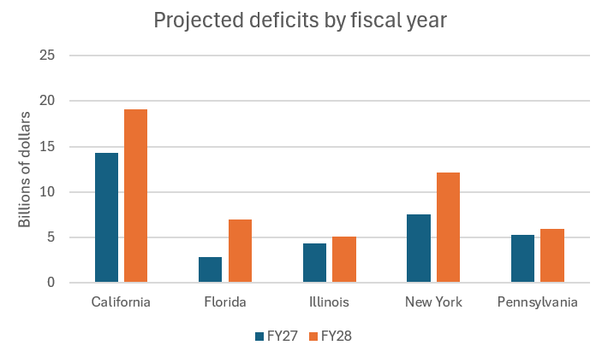
Big states expect growing deficits
Creative Considerations
Note: Figures predate adoption of FY26 budgets, except in New York.
Sources: State documents

Slide 24
How these tools are making a difference
Creative Considerations
After LTBAs showed long-term deficits, New Mexico directed billions of dollars of one-time money to trusts funds to create new recurring revenue sources
In Maryland, LTBAs provided early warnings of looming structural deficits, spurring lawmakers to enact a mix of budget cuts and revenue raising measures
Montana raised its rainy day fund cap by 250% after a stress test showed the state lacked sufficient savings
Utah has used its stress test to create a plan for closing temporary budget gaps, prioritizing actions that will minimize harm to public services and the economy

Slide 25
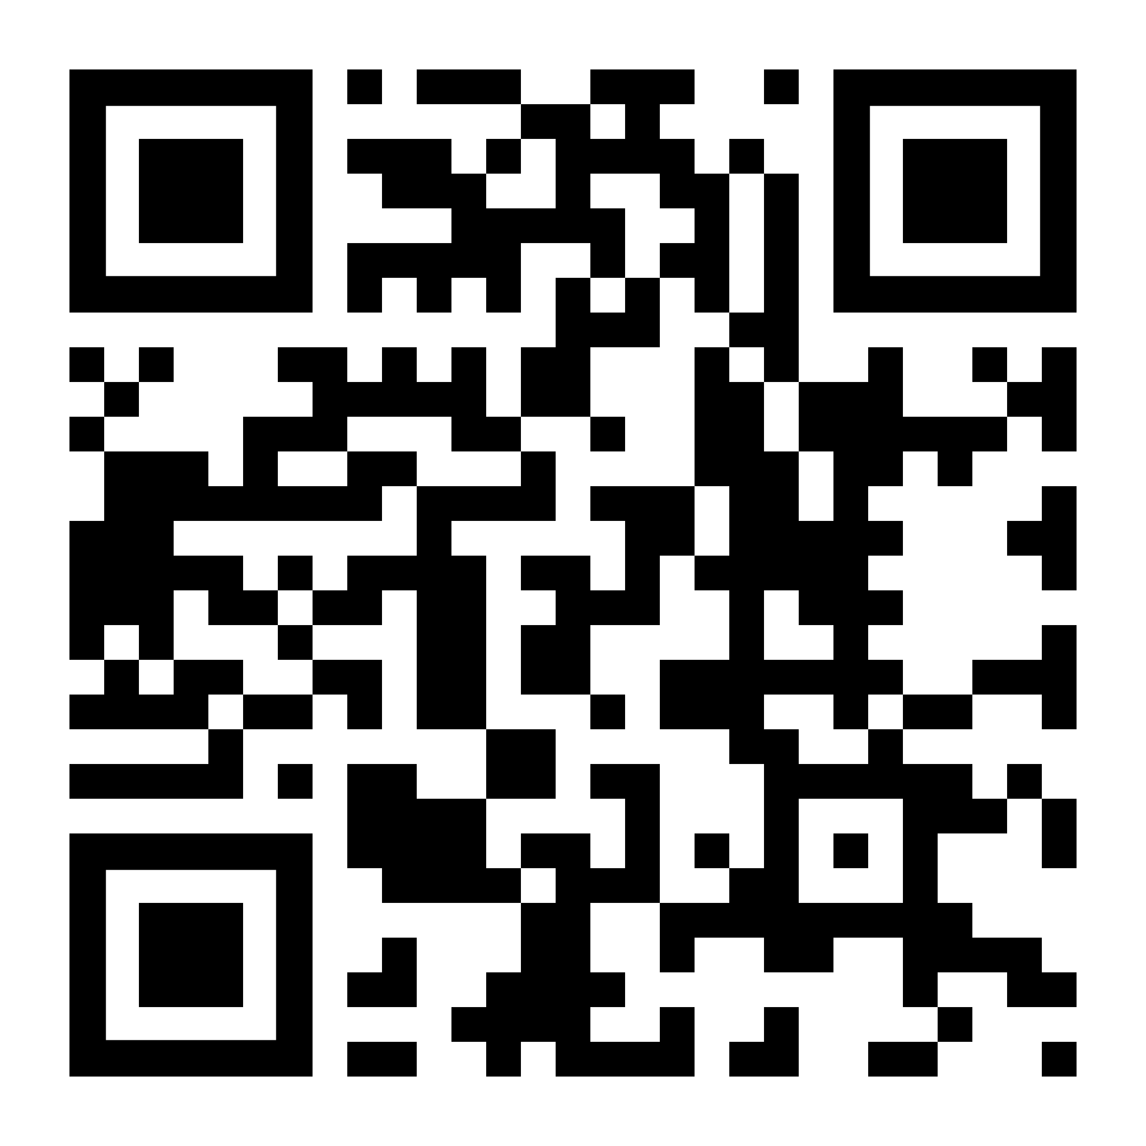
Rainy day fund best practices
Maintain at least one reserve
account for budget stabilization
Deposit rules are tied to volatility
Define clear withdrawal conditions
The size of a rainy day fund is informed by a budget stress test
Rainy day funds are intended to offset the impact of revenue declines and stabilize a state’s fiscal position through economic ups and downs, natural disasters, and declared states of emergency. By establishing a separate savings account for this purpose, states can ensure that resources are available during times of fiscal distress.
One of the ways to build up rainy day funds is to establish deposit rules that encourage a steady accumulation of reserves during periods of economic and revenue growth. States can do that by tying deposits into the rainy day fund to above-normal revenue growth or one-time influxes of revenue.
To ensure that rainy day funds are used as intended, policymakers should create clear withdrawal rules and establish them in law. These rules should make it difficult to use reserves when economic and revenue growth are strong but should not bar access when the money is needed.
Analytical tools such as budget stress tests can provide guidance by estimating how much a particular state should consider saving to address a recession or major disaster. Stress testing allows policymakers to see how state budgets would hold up under a range of economic scenarios.

Slide 26
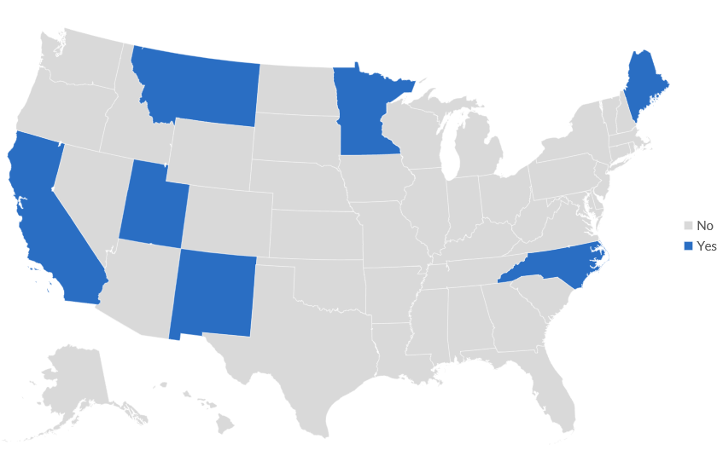
At Least Seven States Have Adjusted RDF Targets Following a Stress Test
Note: State counts reflect Pew’s current body of research and best practices.

Slide 27
Thank you!
Mary Murphy
Senior Director, Fiscal and Economic Policy
mmurphy@pewtrusts.org
202-480-7846
https://www.pew.org/en/projects/state-fiscal-policy
https://www.pew.org/fiscal50

